Slide 1
Protein-Protein Interactions Tools and Approaches
John “Scooter” Morris
June 6, 2016
Eötvös Loránd University
Budapest, Hungary

Slide 2
Today’s Agenda
Time | Topic
10.00 – 11.00 | Introductions – Why are protein-protein interactions important?
11.00 – 12.30 | Protein-protein interaction networks – I Getting the data
12.30 – 13.30 | Lunch
13.30 – 15.00 | Protein-protein interaction networks – II Network approaches to visualizing and analyzing protein-protein interactions Introduction to Cytoscape - I
15.00 – 15.30 | Break
15.30 – 17.00 | Introduction to Cytoscape – II Hands-on
17.00 – 18.00 | Workflows

Slide 3
Introductions
John “Scooter” Morris
2010-Current
Adjunct Assistant Professor, Pharmaceutical Chemistry
2004-Current
Director, NCRR Resource for Biocomputing, Visualization, and Informatics (RBVI) @ UCSF
1985-2004
Principal Systems Architect: Genentech, Inc.
Cytoscape core team since 2006
Author or co-author of several Cytoscape apps
structureViz2, clusterMaker2, chemViz2, stringApp, CyAnimator

Slide 4
What is this course about?
Protein-protein interactions
Some background
Some techniques
Two tools:
Cytoscape – network visualization and analysis
Chimera – structural visualization and analysis
Why those tools?
It’s what our lab works on ☺

Slide 5
Why?
Why are protein-protein interactions important?
You tell me…

Slide 6
Why?
Each participant
Name
Introduce your image
Say why protein-protein interactions are important

Slide 7
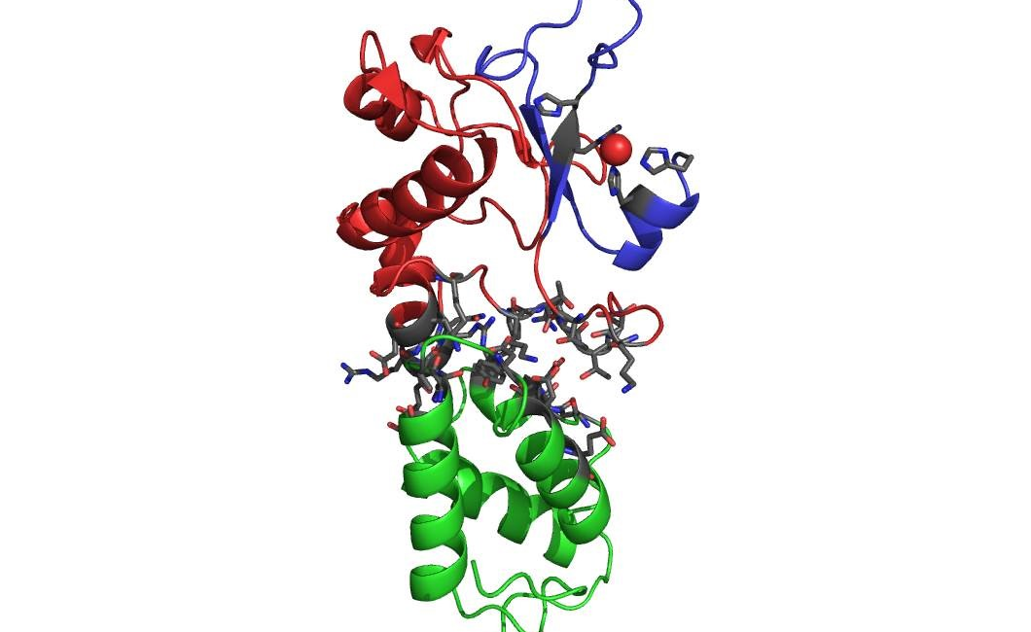
Katalin Borsos

Slide 8
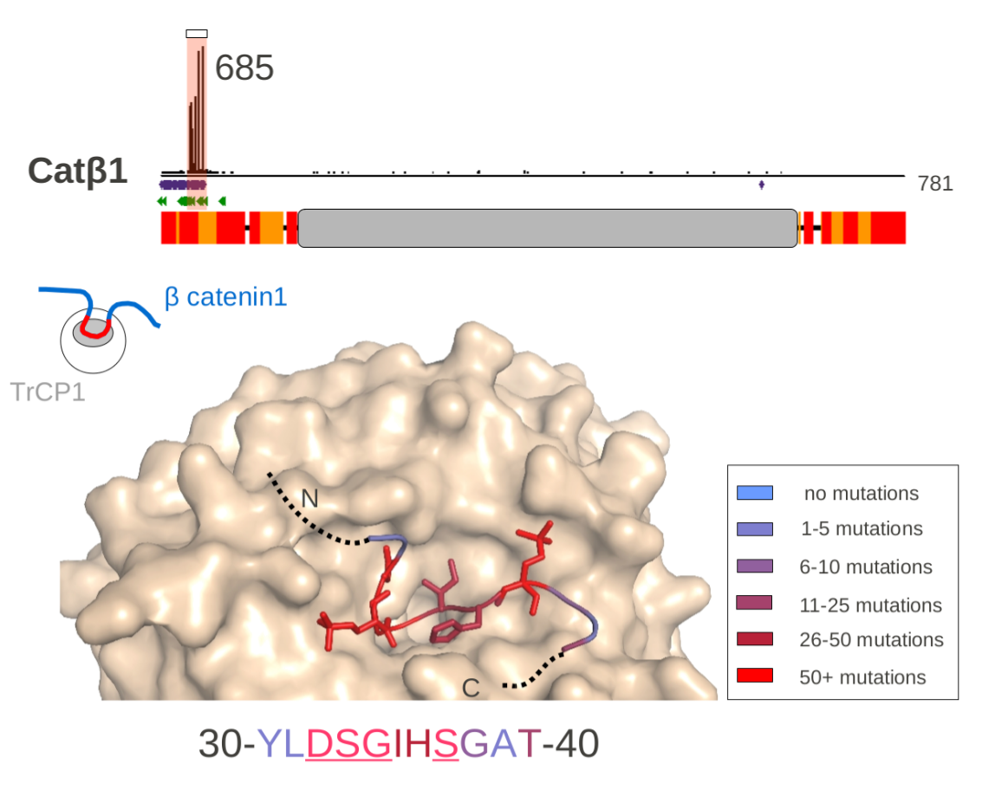
Borbála Soltész

Slide 9
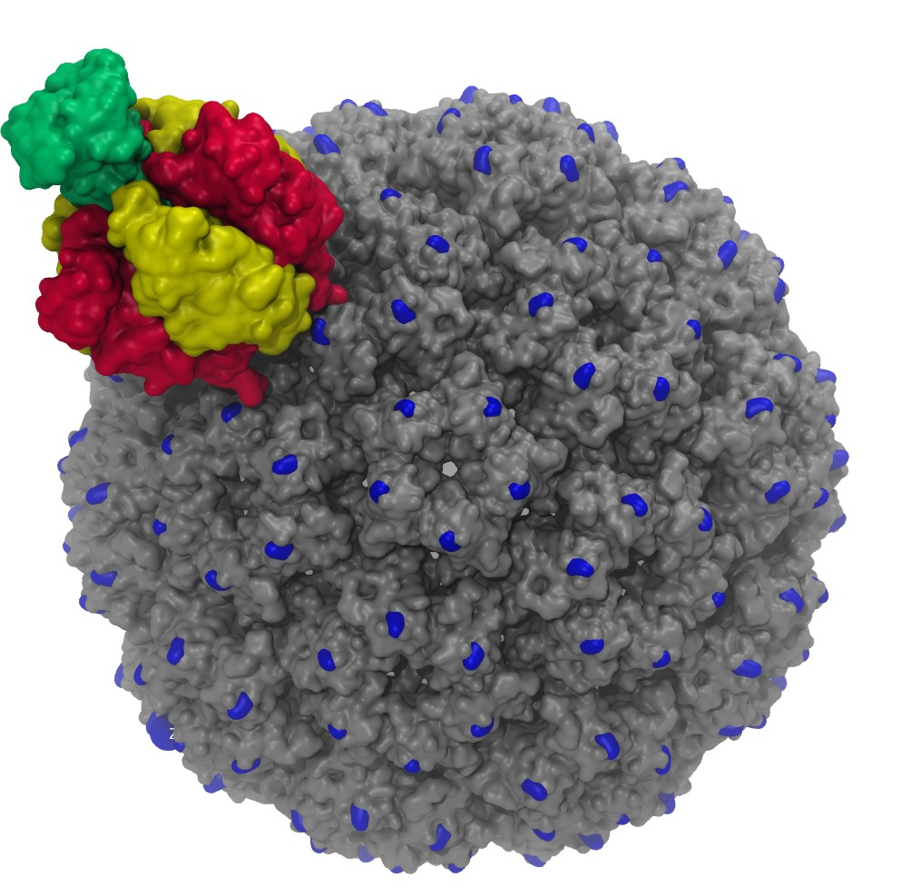
Ákos Gellért

Slide 10
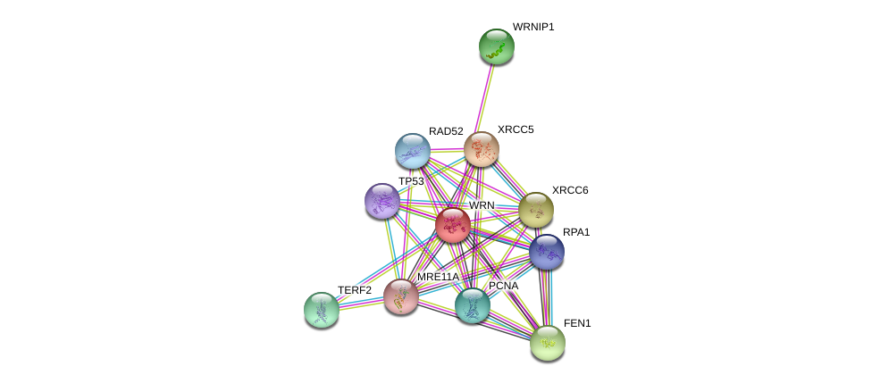
Kerepesi Csaba

Slide 11
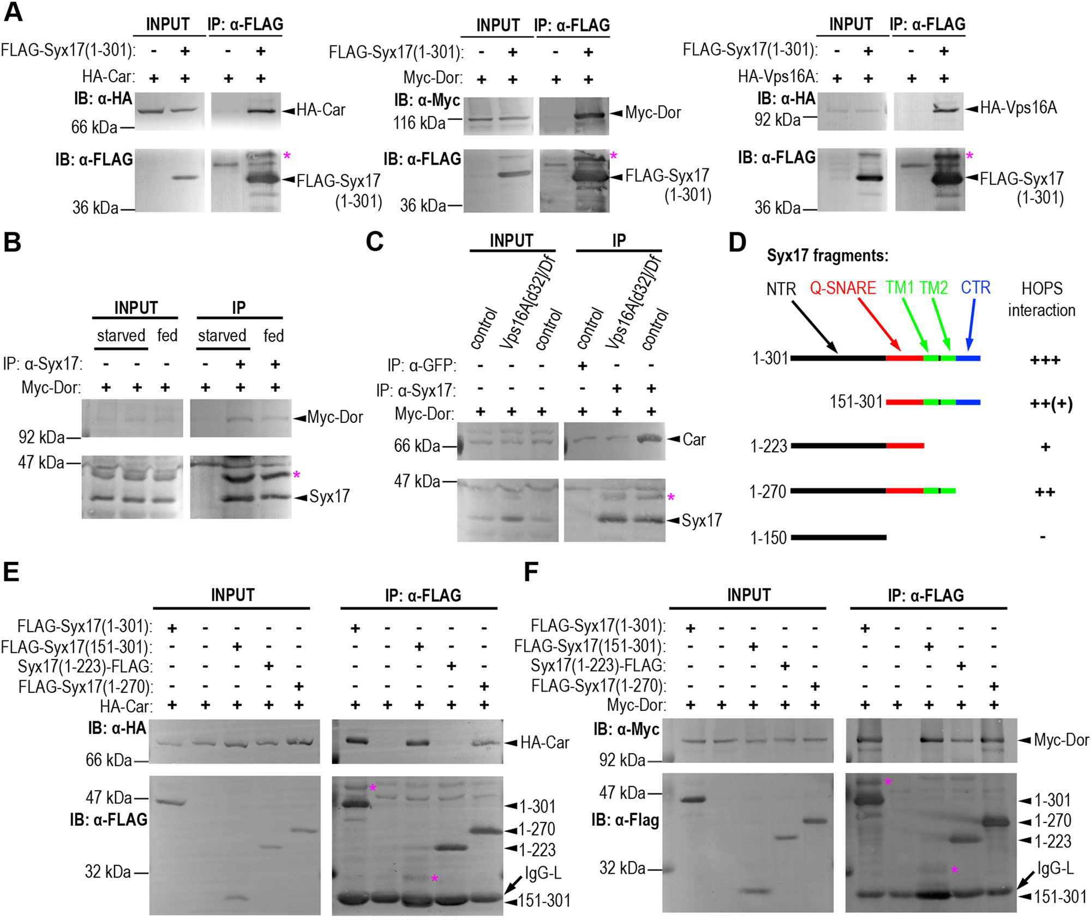
Takáts Szabolcs

Slide 12
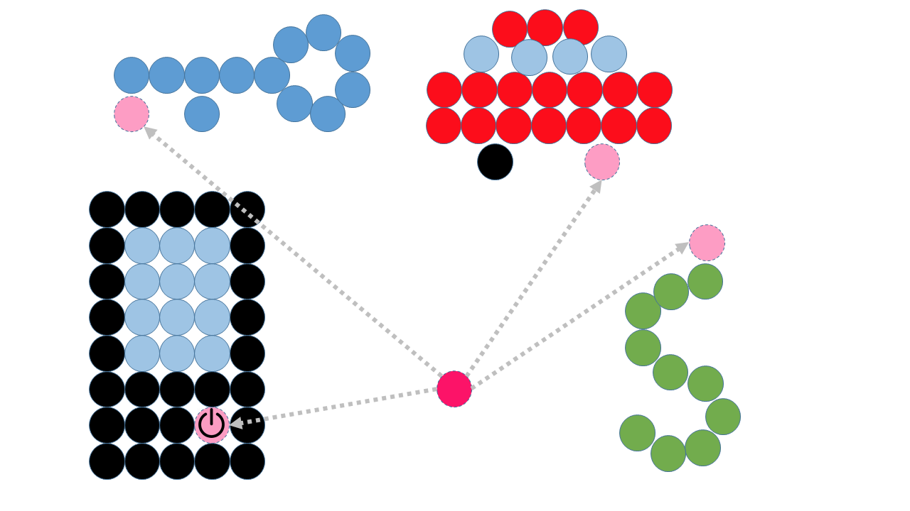
Lajos Pintér

Slide 13
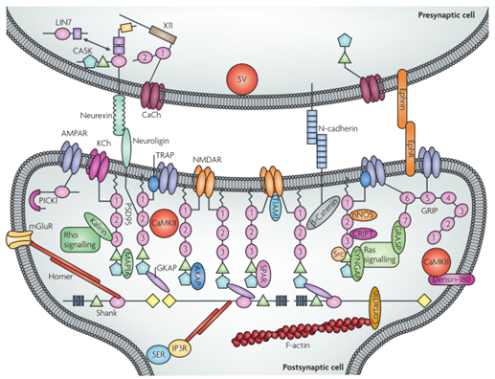
Bertalan Kovács

Slide 14
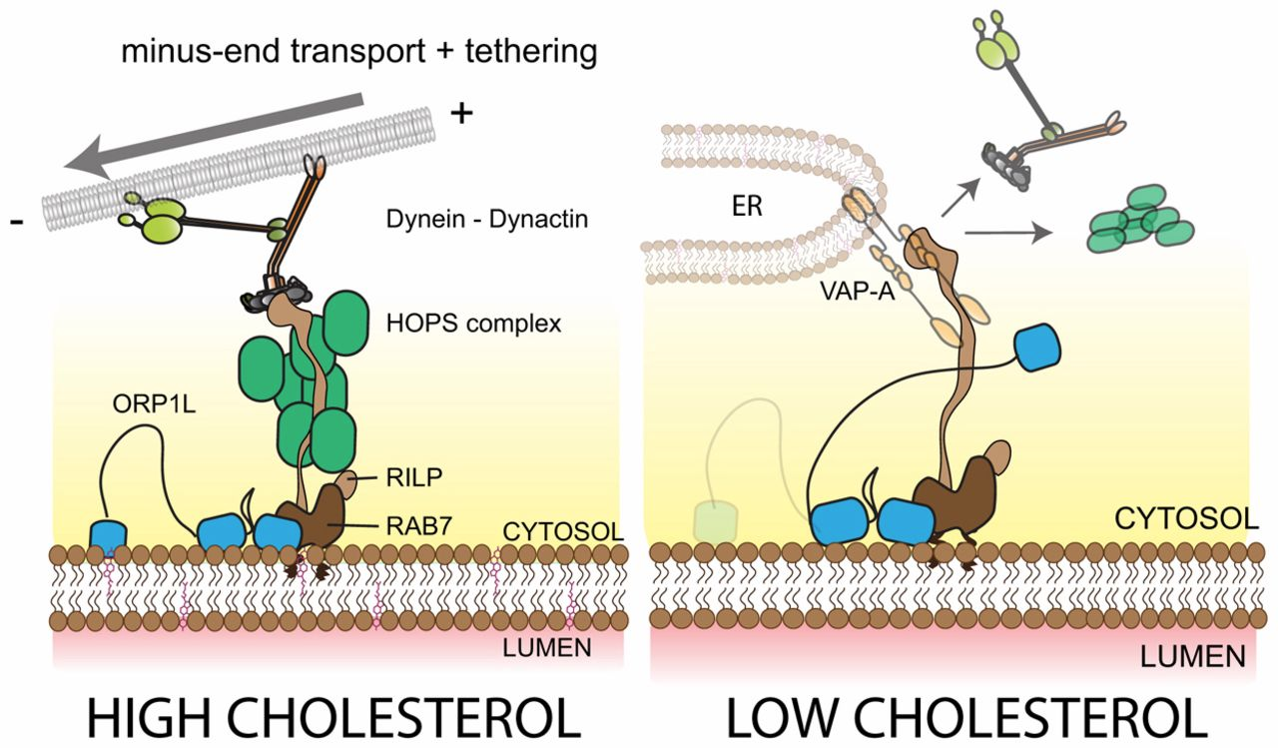
Tóth Sarolta

Slide 15
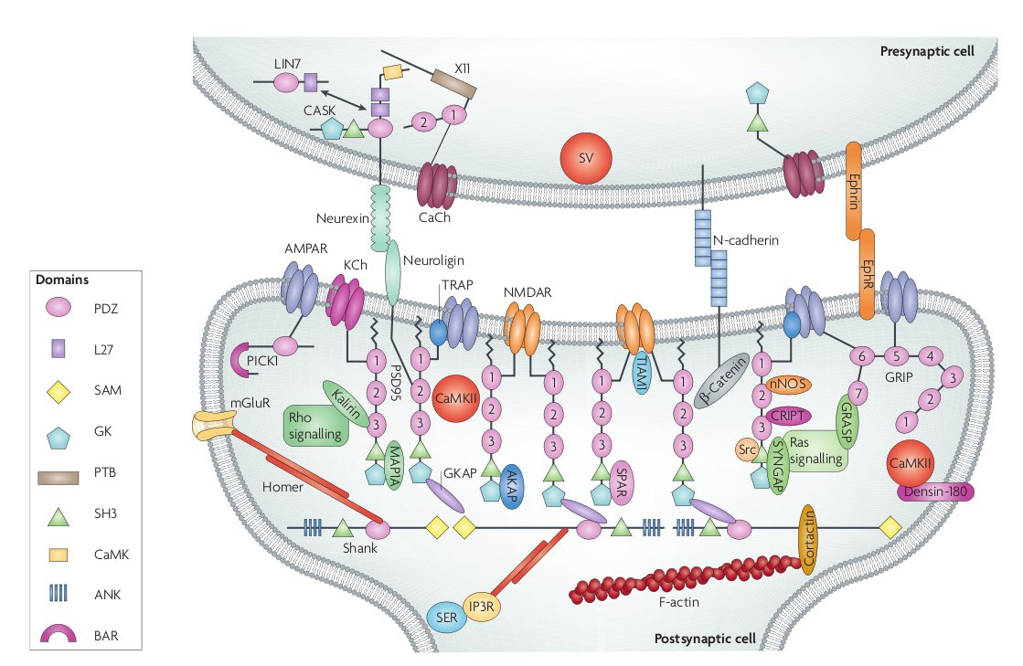
Korai Anett Márta

Slide 16
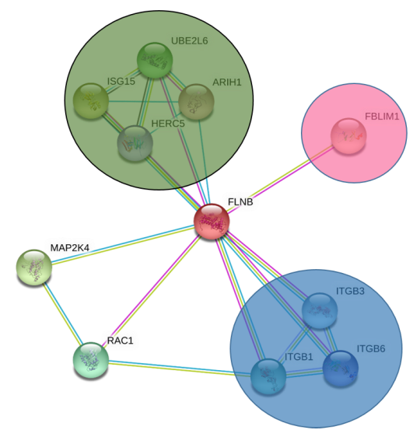
Sándor Babik

Slide 17
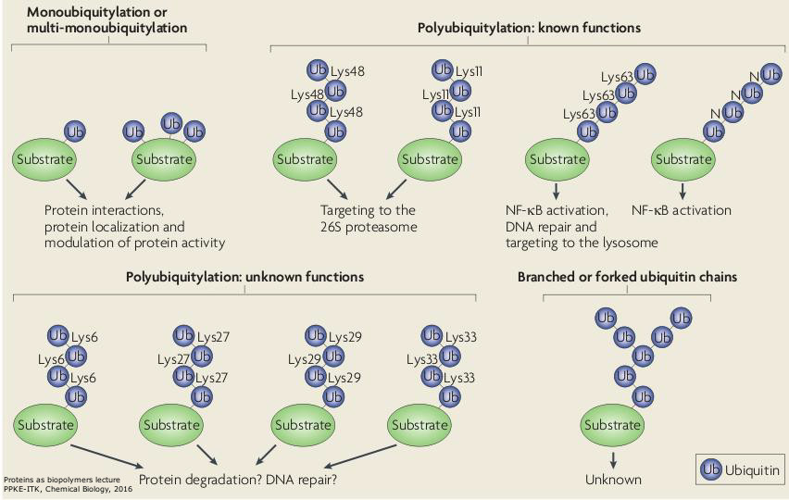
Tóth Ágota

Slide 18
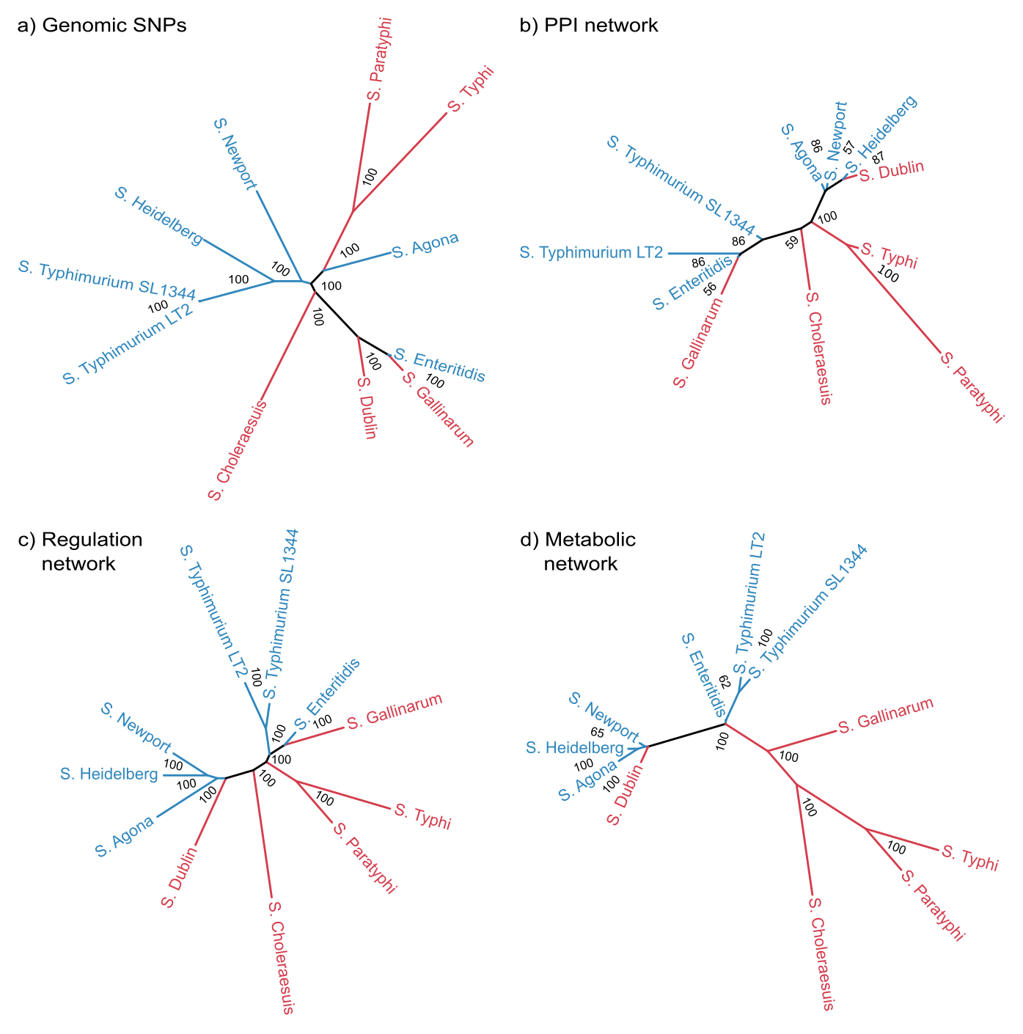
Ari Eszter

Slide 19
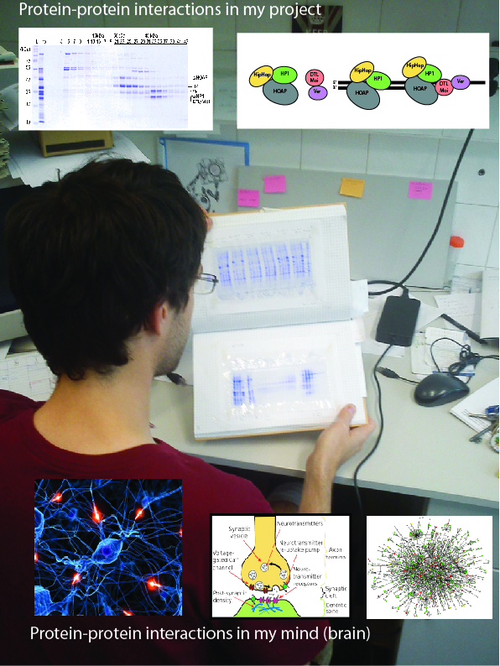
Balázs Vedelek

Slide 20
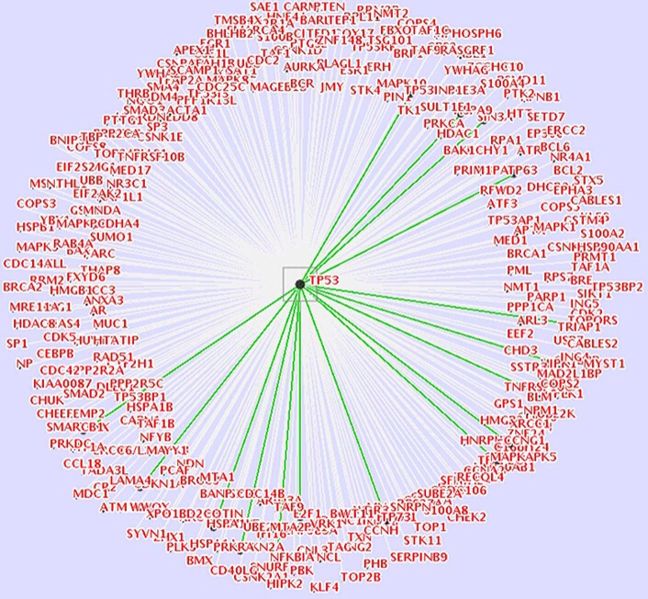
Fichó Erzsébet

Slide 21
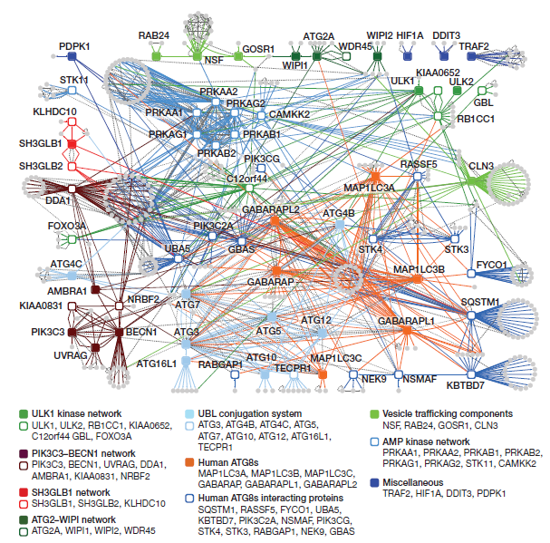
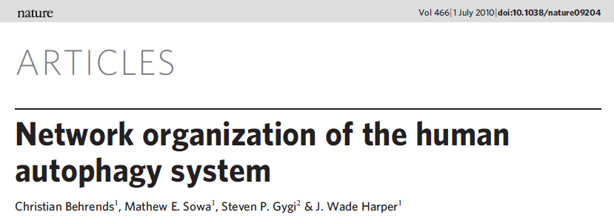
Hegedűs Krisztina

Slide 22
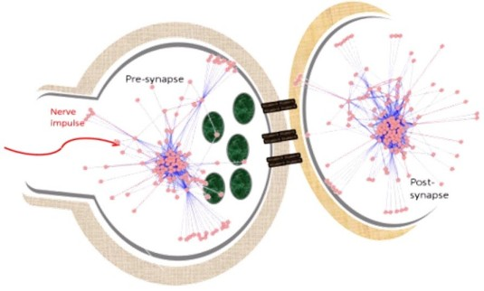
Annamária Kiss-Tóth

Slide 23
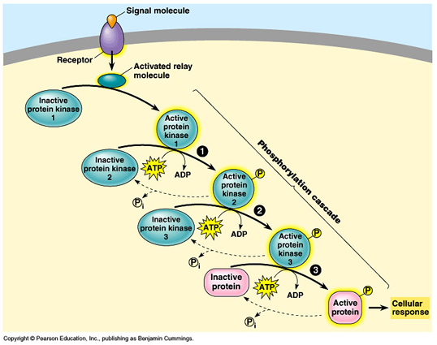
Brigitta Kállai

Slide 24
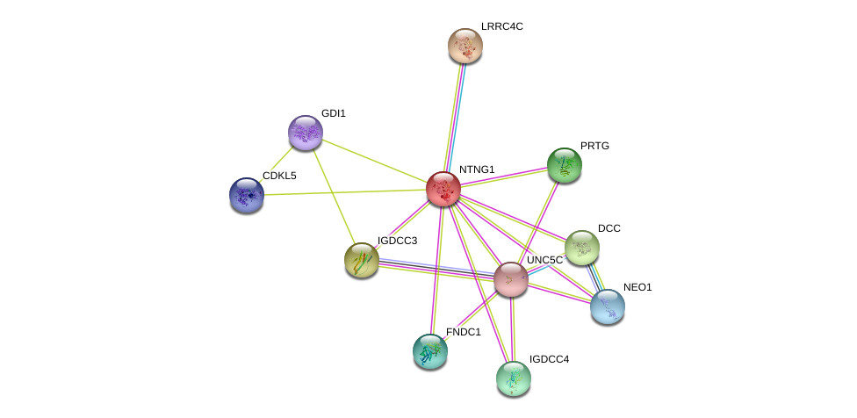
Laura Laszlo

Slide 25
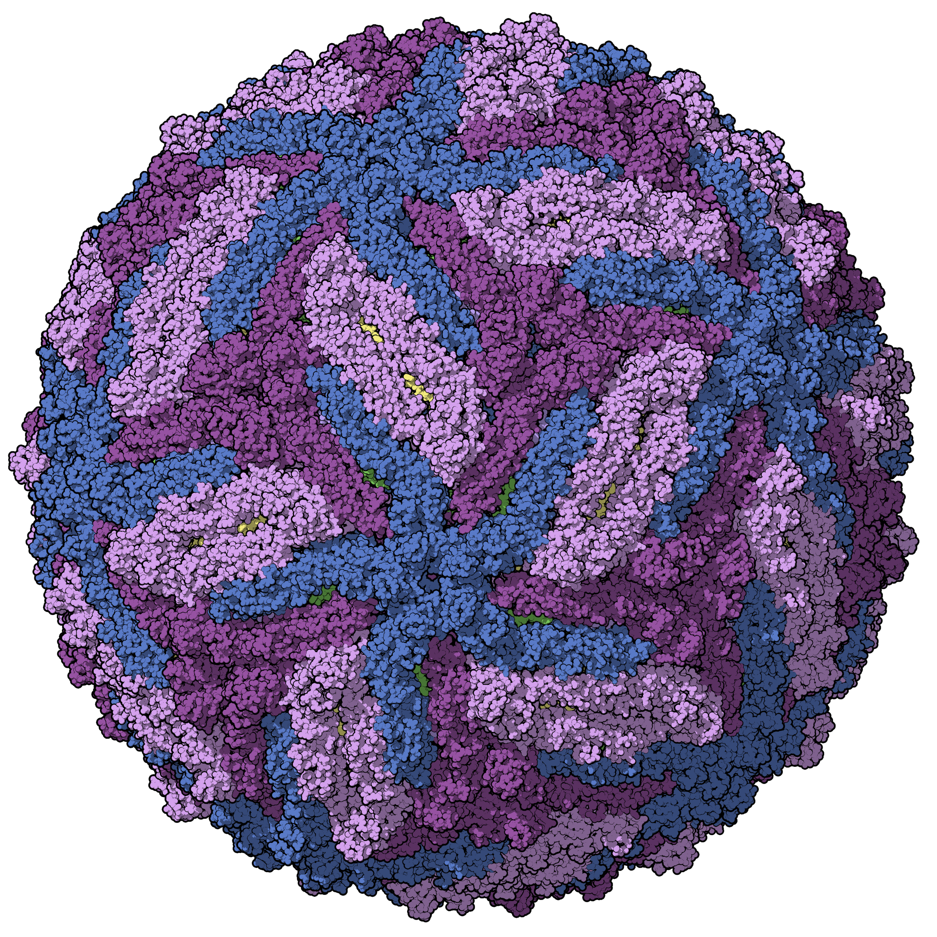
Balázs Szalkai

Slide 26
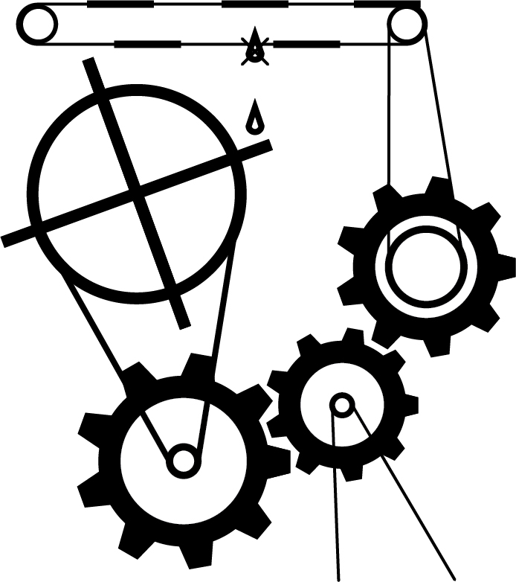
Bence Széplaki

Slide 27
Others?

Slide 28
Why
classic view of drug action
drug
target
therapeutic effect
off
target
side effect
network view of drug action
target 1
target 2
therapeutic effects
+ side effects
drug
target 3
target 4
Csermely, Korcsmaros et al., Pharmacol & Therap 138:333-408 (2013)

Slide 29
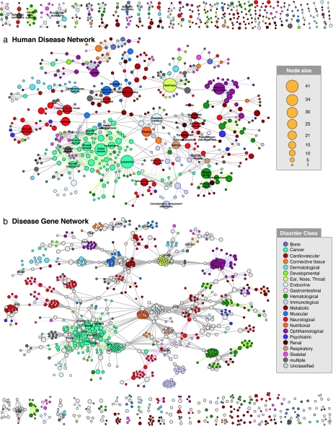
Why
Proc Natl Acad Sci U S A. 2007 May 22;104(21):8685-90. Epub 2007 May 14.
The human disease network.
Goh KI¹, Cusick ME, Valle D, Childs B, Vidal M, Barabási AL.

Slide 30
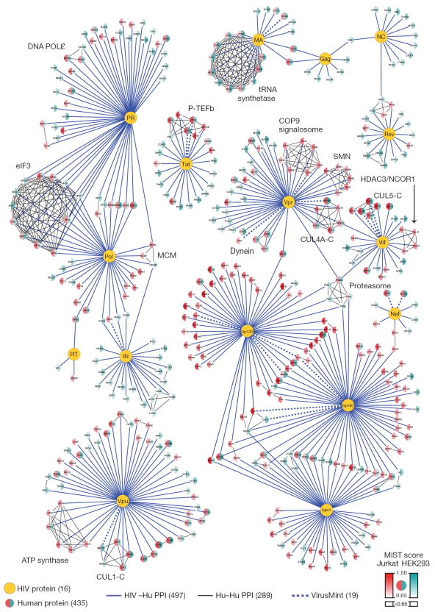
Why
Nature. 2011 Dec 21;481(7381):365-70. doi: 10.1038/nature10719.
Global landscape of HIV-human protein complexes.
Jäger S, et. al

Slide 31
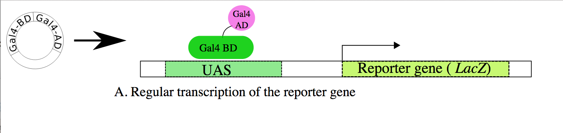
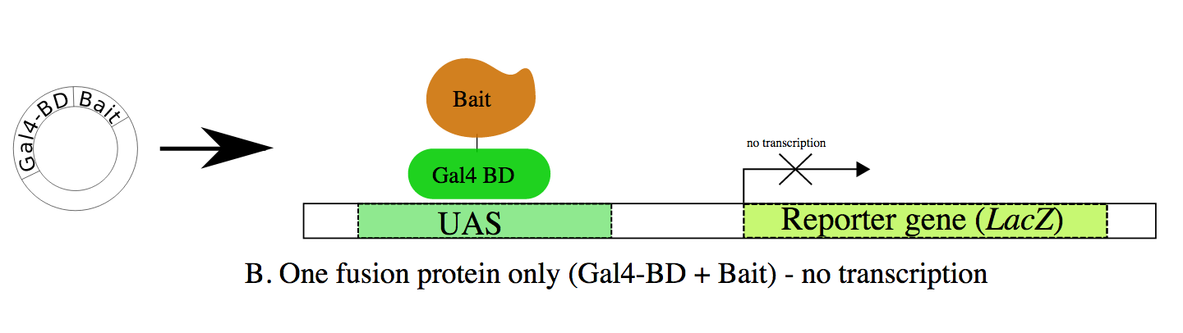
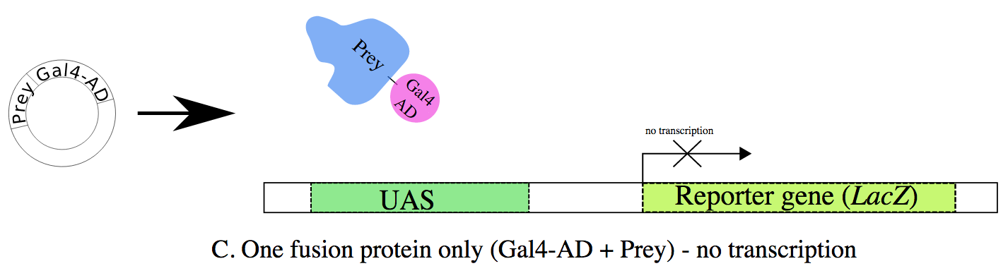
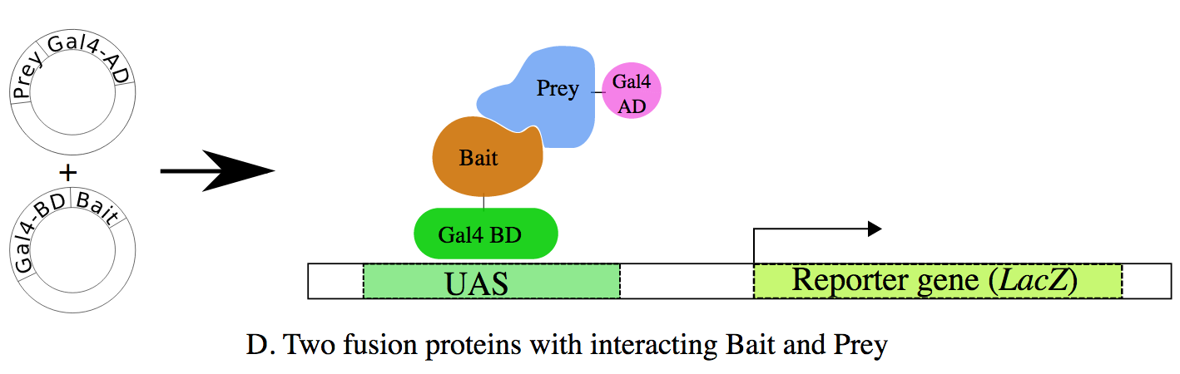
Experimental Techniques
High throughput
Yeast 2 hybrid
Notes:
Overview of two-hybrid assay, checking for interactions between two proteins, called here Bait and Prey. A. The Gal4 transcription factor gene produces a two-domain protein (BindingDomain: BD and ActivatingDomain:AD) essential for transcription of the reporter gene (LacZ). B,C. Two fusion proteins are prepared: Gal4BD+Bait and Gal4AD+Prey. Neither of them are usually sufficient to initiate transcription (of the reporter gene) alone. D. When both fusion proteins are produced and the Bait part of the first fusion protein interacts with the Prey part of the second, transcription of the reporter gene occurs.

Slide 32
Experimental Techniques
High throughput
Yeast 2 hybrid
Pros:
Relatively low-tech
Scalable
Cons:
High false positive and false negative rate

Slide 33
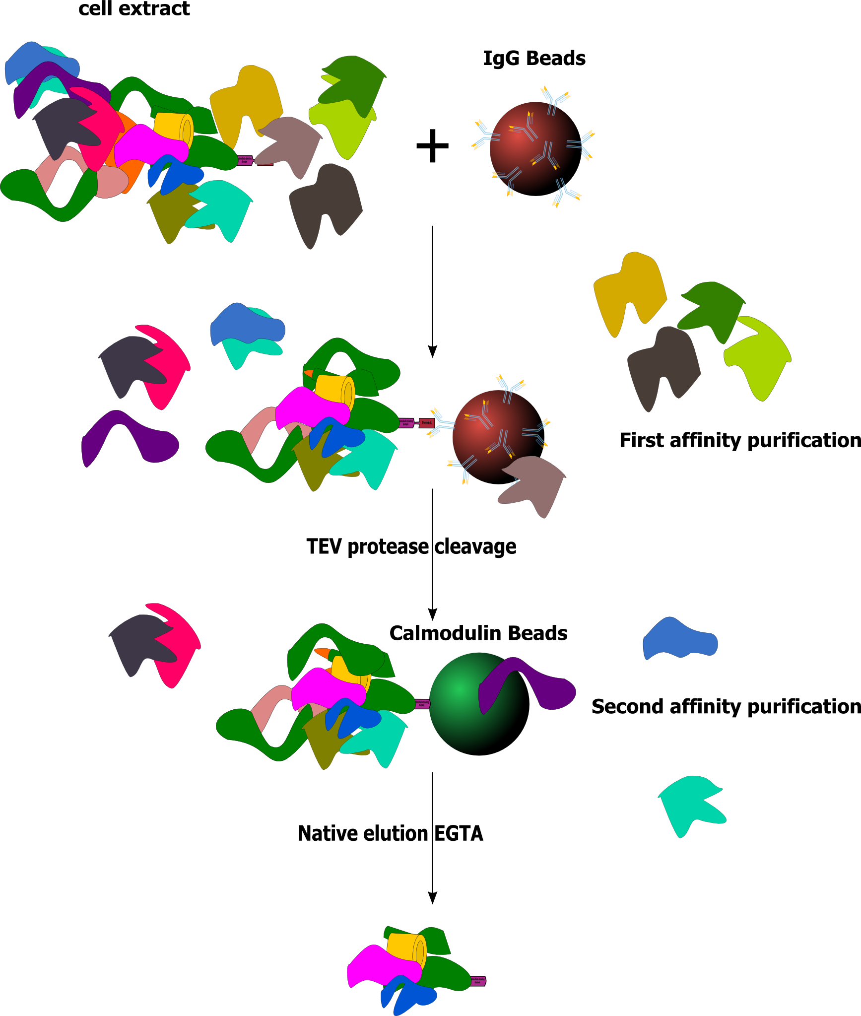
Experimental Techniques
High throughput
Yeast 2 hybrid
Tandem Affinity Purification/Mass Spectrometry (AP/MS)
Notes:
1. Create fusion protein (bait) with your tag
2. Lyse cell and mix with IgG beads
3. Wash
4. Cleave with TEV protease
5. Bind to Calmodulin Beads
6. Wash
7. Remove beads & send to Mass Spec

Slide 34
Experimental Techniques
High throughput
Yeast 2 hybrid
Tandem Affinity Purification/Mass Spectrometry (AP/MS)
Pros:
Quantitative results in vivo
Cons:
Tag can obscure binding
Protease can cleave protein
Not good for transient interactions
Notes:
1. Create fusion protein (bait) with your tag
2. Lyse cell and mix with IgG beads
3. Wash
4. Cleave with TEV protease
5. Bind to Calmodulin Beads
6. Wash
7. Remove beads & send to Mass Spec

Slide 35
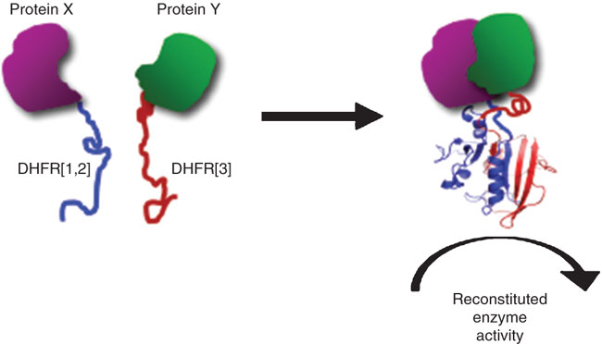
Experimental Techniques
High throughput
Yeast 2 hybrid
Tandem Affinity Purification/Mass Spectrometry (AP/MS)
Protein-fragment complementation assays

Slide 36
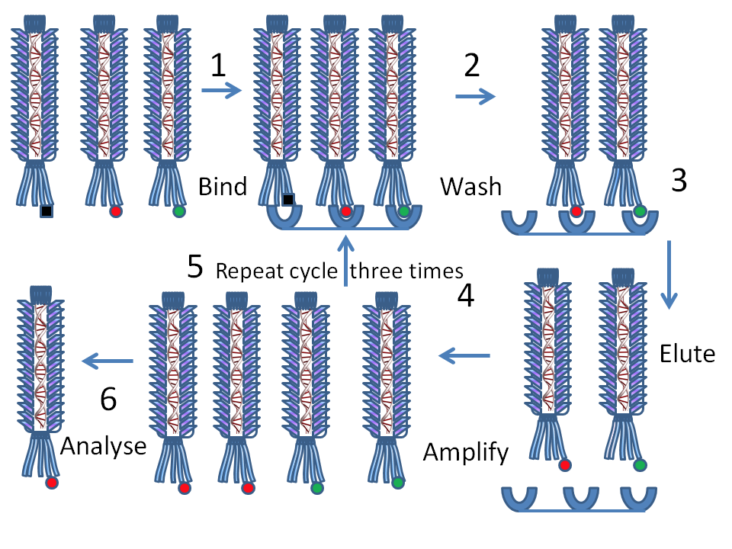
Experimental Techniques
High throughput
Yeast 2 hybrid
Tandem Affinity Purification/Mass Spectrometry (AP/MS)
Protein-fragment complementation assays
Phage display

Slide 37
Experimental Techniques
High throughput
Yeast 2 hybrid
Tandem Affinity Purification/Mass Spectrometry (AP/MS)
Protein-fragment complementation assays
Phage display
Protein microarrays
Chemical crosslinking

Slide 38
Experimental Techniques
Jensen & Bork, Science, 2008

Slide 39
Experimental Techniques
Genetic interactions
Measures functional linkage between genes
Orthogonal to physical interaction techniques
Two approaches
SGA (Synthetic genetic array)
E-MAP (Epistatic MiniArray Profile)

Slide 40
Experimental Techniques
A
B
Growth_{A}
Growth_{B}
A
B
Growth_{AB}
Interaction_{AB} = Growth_{AB} – Growth_{A}*Growth_{B}

Slide 41
Experimental Techniques
A
B
+
B
-
A
A
0
B

Slide 42
Experimental Techniques
Genetic Interactions (E-MAP)
High throughput
Quantitative
Can provide corroboration to PPI data

Slide 43
Experimental Techniques
Low throughput
Xray crystallography
NMR
SAXS
ELISA Binding Assays
Co-IP

Slide 44
Computational Techniques
Text mining
Search literature for references to protein-protein interactions
Orthology
Predicts interaction based orthologous pairs in another species
Domain pairs
Predicts interaction based on domains interacting in other proteins

Slide 45
Public Repositories
Pathway data
WikiPathways
Reactome
BioCyc
KEGG
Pathway Commons

Slide 46
Public Repositories
PPI Data
Pathway Commons
BioGRID
IntAct
Model organisms databases (e.g. SGD)
STRING

Slide 47
Scooter Morris
June 6, 2016
Eötvös Loránd University
Budapest, Hungary

Slide 48
Outline
Biological Networks
Why Networks?
Biological Network Taxonomy
Analytical Approaches
Visualization
Introduction to Cytoscape
Hands on Tutorial
Data import
Layout and apps
Notes:
EDIT: schedule

Slide 49
Introductions
John “Scooter” Morris
2010-Current
Adjunct Assistant Professor, Pharmaceutical Chemistry
2004-Current
Director, NCRR Resource for Biocomputing, Visualization, and Informatics (RBVI) @ UCSF
1985-2004
Principal Systems Architect: Genentech, Inc.
Cytoscape core team since 2006
Author or co-author of several Cytoscape apps
structureViz2, clusterMaker2, chemViz2, stringApp, CyAnimator
Notes:
EDIT: introductions per presenter

Slide 50
Introductions
Nadezhda T. Doncheva
2016-Current
Postdoc researcher at the Novo Nordisk Foundation Center for Protein Research & Center for non-coding RNA in Technology and Health in Copenhagen
2010-2016:
Research scientist and PhD student at the Max Planck Institute for Informatics in Saarbrücken
Author or co-developer of several Cytoscape plugins:
RINalyzer, structureViz2, setsApp, NetworkAnalyzer, NetworkPrioritizer

Slide 51
Introductions
Barry Demchak
2012-Current
Chief Software Architect, Project Manager for National Resource for Network Biology (NRNB, Ideker Lab)
2005-2012
PhD Computer Science and Engineering, UC San Diego
1987-current
President, Torrey Pines Software, Inc
Cytoscape core team since 2012
Architect of Cytoscape Cyberinfrastructure
Notes:
EDIT: introductions per presenter

Slide 52
Introductions
Christian Zmasek
2015-Current
Cytoscape core team (Ideker Lab)
2006-2015
Postdoc (Sanford-Burnham) Comparative functional genomics
Rintaro Saito, PhD
2014-Current
Associate Project Scientist (Kumar Lab)
2011-2014
Visiting Assistant Professor (Ideker Lab)
2002-2011
Assistant Professor (Keio University)
Notes:
EDIT: introductions per presenter

Slide 53
Introductions
You?
Clinician
Biologist
Bioinformatician
Computer Scientist
Chemist
Other?

Slide 54
Installation
How many have installed:
Cytoscape 3.4.0
Apps:
Omics Analysis Collection
Notes:
EDIT: Update per provisions

Slide 55
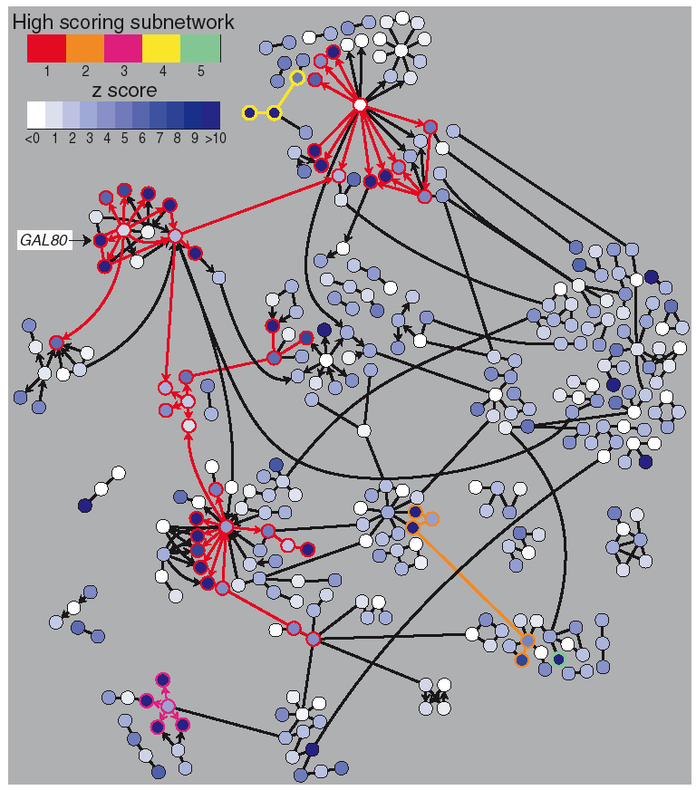
Why Networks?
Networks are…
Commonly understood
Structured to reduce complexity
More efficient than tables
Network tools allow…
Analysis
Characterize network properties
Identify hubs and subnets
Classify, quantify and correlate, e.g.,
cluster nodes by associated data
Visualization
Explore data overlays
Interpret mechanisms, e.g., how a process
is modulated or attenuated by a stimulus

Slide 56
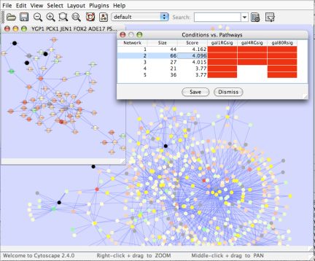
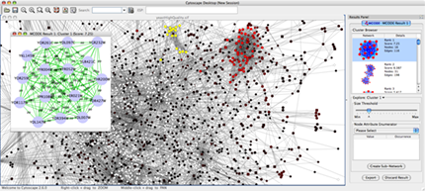
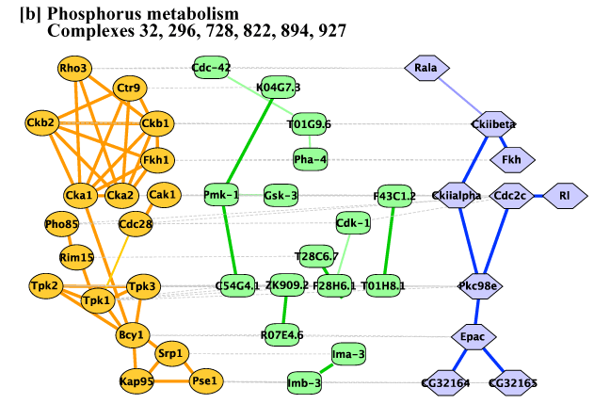
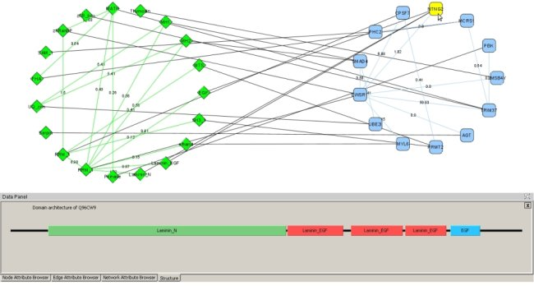
Applications of Network Biology
Gene Function Prediction shows connections to sets of genes/proteins involved in same biological process
Detection of protein complexes/subnetworks discover modularity & higher order organization (motifs, feedback loops)
Network evolution biological process(s) conservation across species
Prediction of interactions & functional associations statistically significant domain-domain correlations in protein interaction network to predict protein-protein or genetic interaction
mCode, University of Toronto
jActiveModules, UCSD
PathBlast, UCSD
DomainGraph, Max Planck Institute
Notes:
Gene Function Prediction – basic but important, examining genes (proteins) in a network context shows connections to sets of genes/proteins involved in same biological process that are likely to function in that process
Detection of protein complexes/other modular structures – although interaction networks are based on pair-wise interactions, there is clear evidence for modularity & higher order organization (motifs, feedback loops)
Network evolution – biological process(s) conservation across species (PathBLAST, NetworkBLAST to align p-p interaction networks & clusters)
Prediction of new interactions and functional associations – Statistically significant domain-domain correlations in protein interaction network suggest that certain domain (and domain pairs) mediate protein binding. Machine learning extends this to suggest to predict protein-protein or genetic interaction through integration of diverse types of evidence for interaction

Slide 57
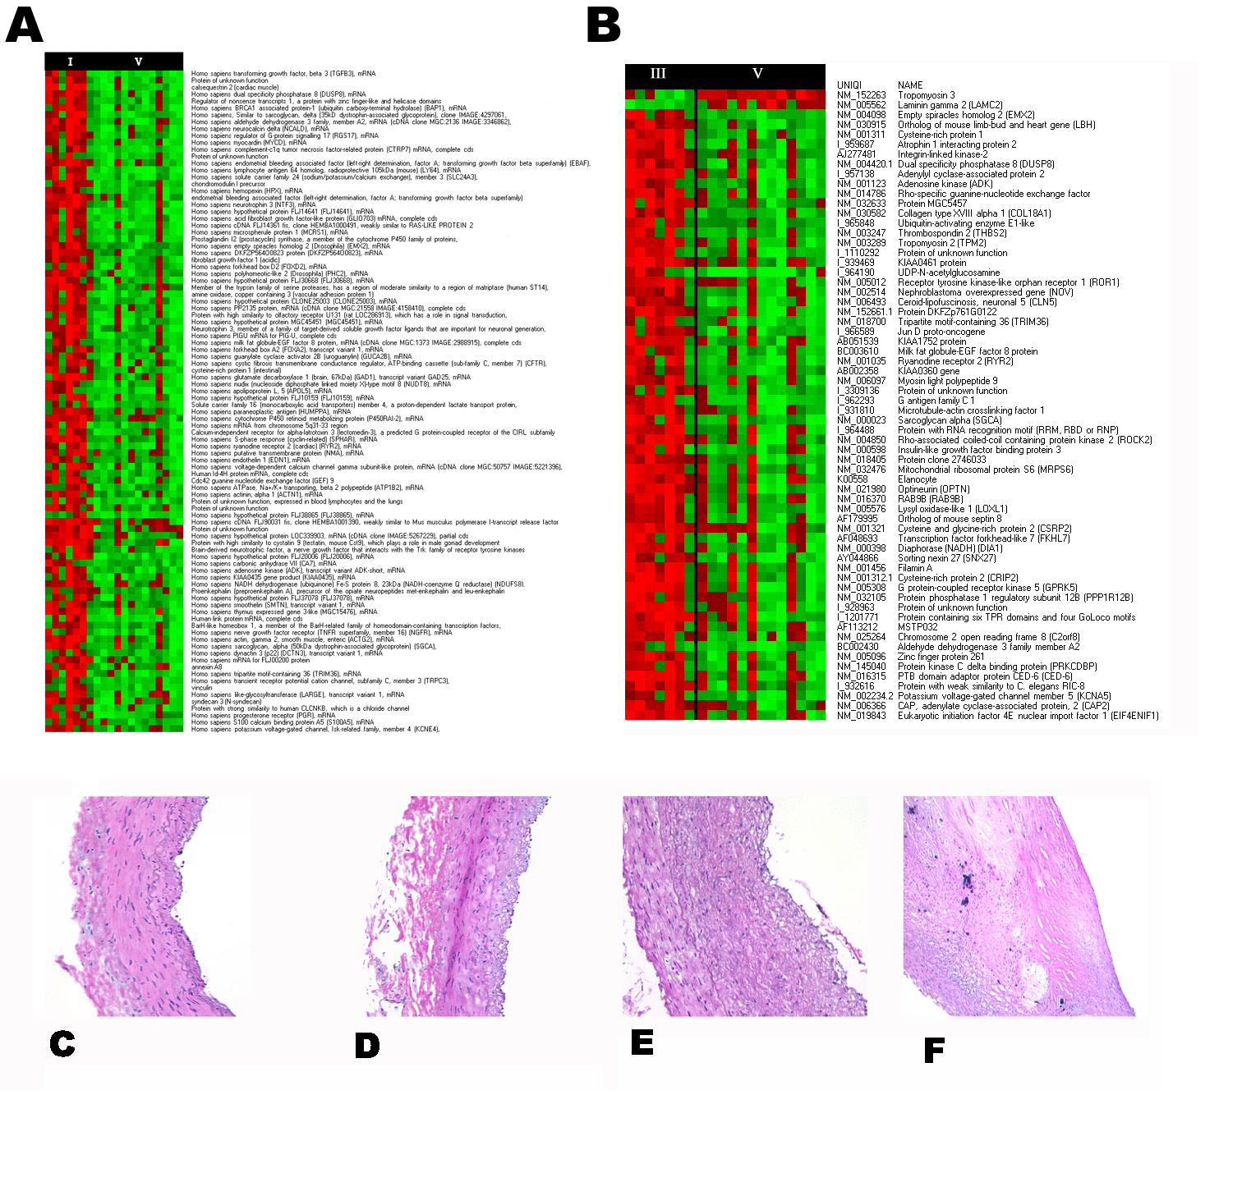
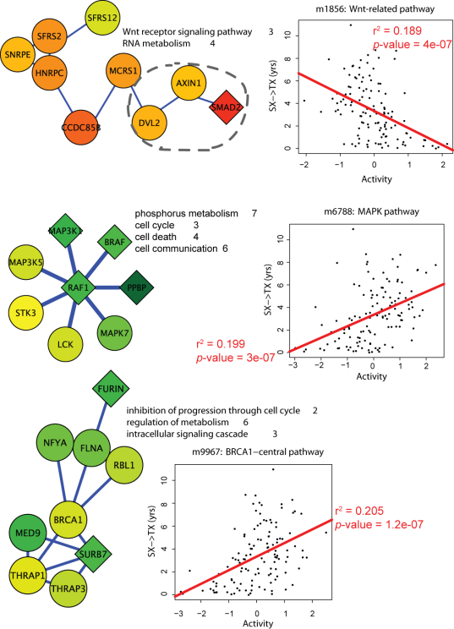
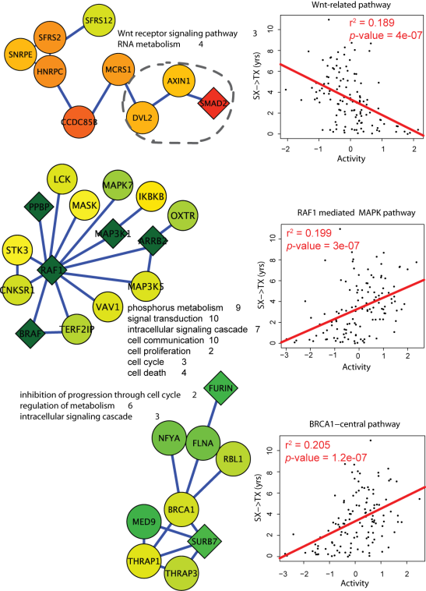
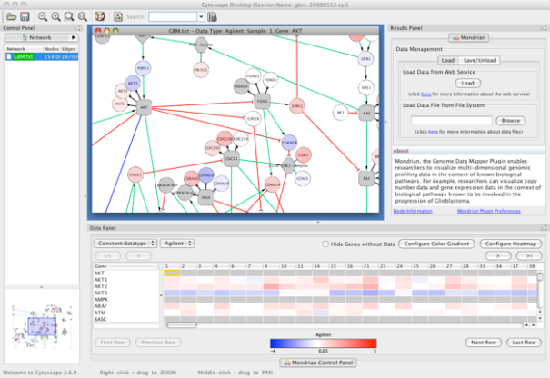
Applications in Disease
Identification of disease subnetworks – identification of disease network subnetworks that are transcriptionally active in disease.
Subnetwork-based diagnosis – source of biomarkers for disease classification, identify interconnected genes whose aggregate expression levels are predictive of disease state
Subnetwork-based gene association – map common pathway mechanisms affected by collection of genotypes (SNP, CNV)
Agilent Literature Search
PinnacleZ, UCSD
Mondrian, MSKCC
Notes:
Identification of disease subnetworks – identification of disease network subnetworks that are transcriptionally active in disease. These suggest key pathway components in disease progression and provide leads for further study and potential therapeutic targets
Subnetwork-based diagnosis – subnetworks also provide a rich source of biomarkers for disease classification, based on mRNA profiling integrated with protein networks to identify subnetwork biomarkers (interconnected genes whose aggregate expression levels are predictive of disease state)
Subnetwork-based gene association – molecular networks will provide a powerful framework for mapping common pathway mechanisms affected by collection of genotypes (SNP, CNV)

Slide 58
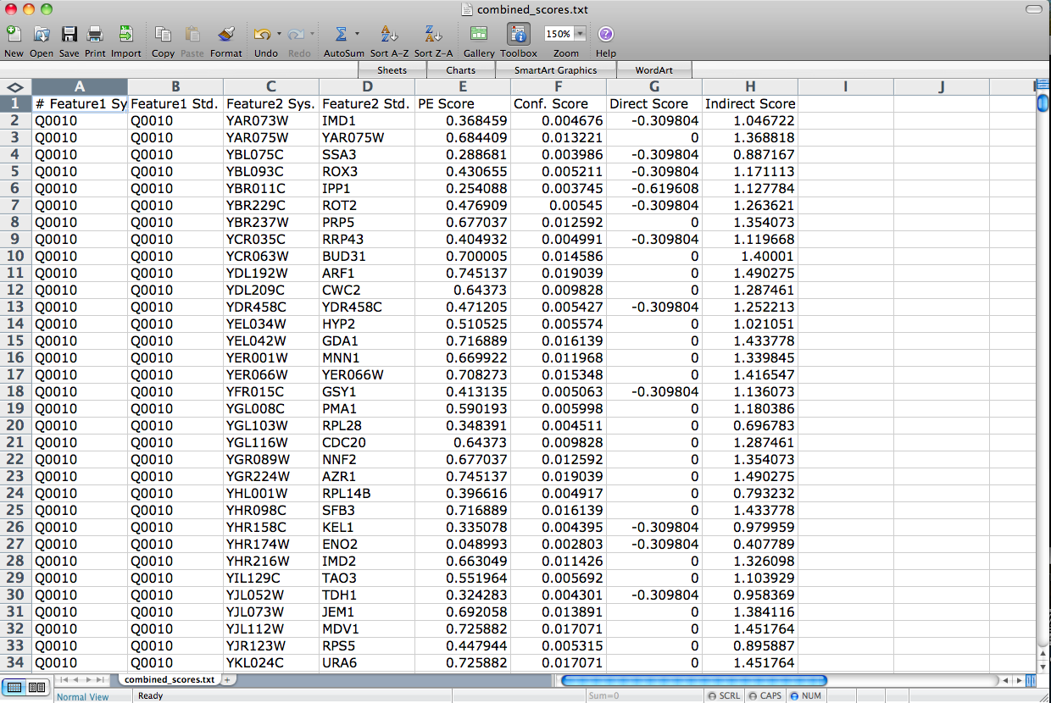
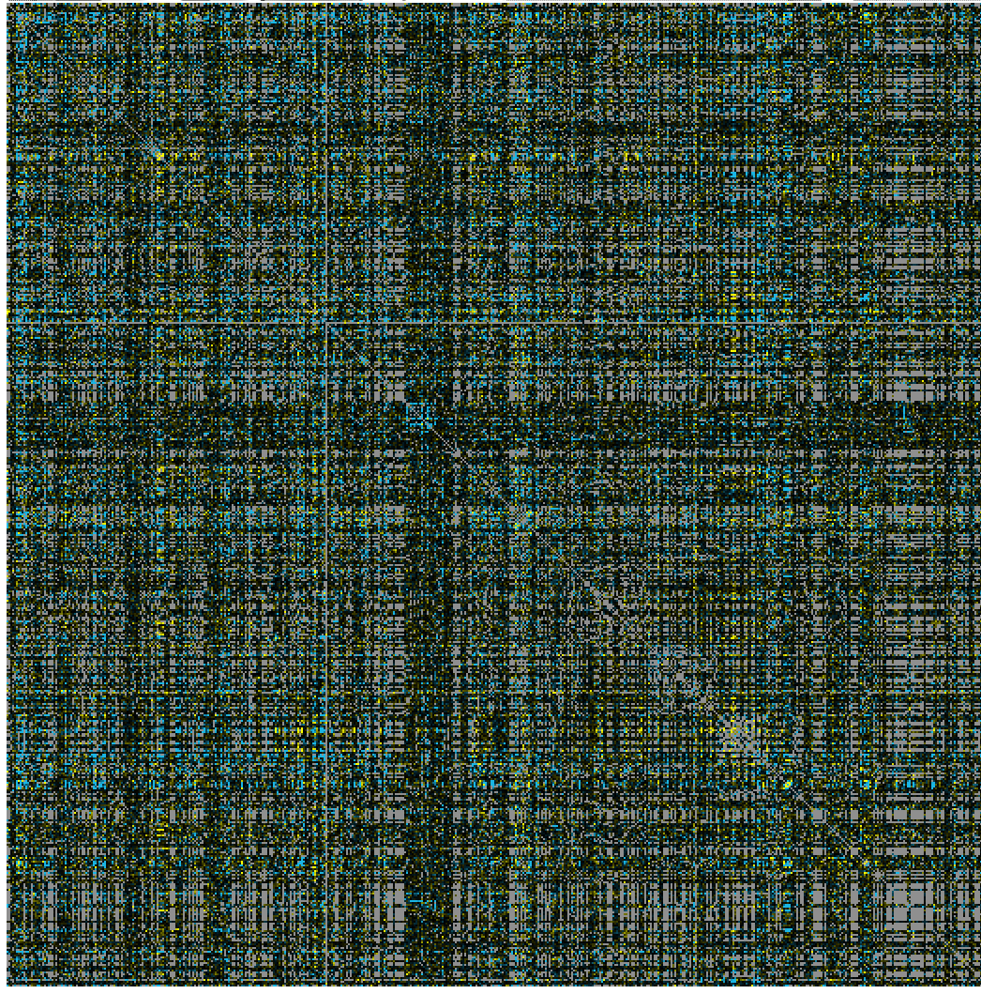
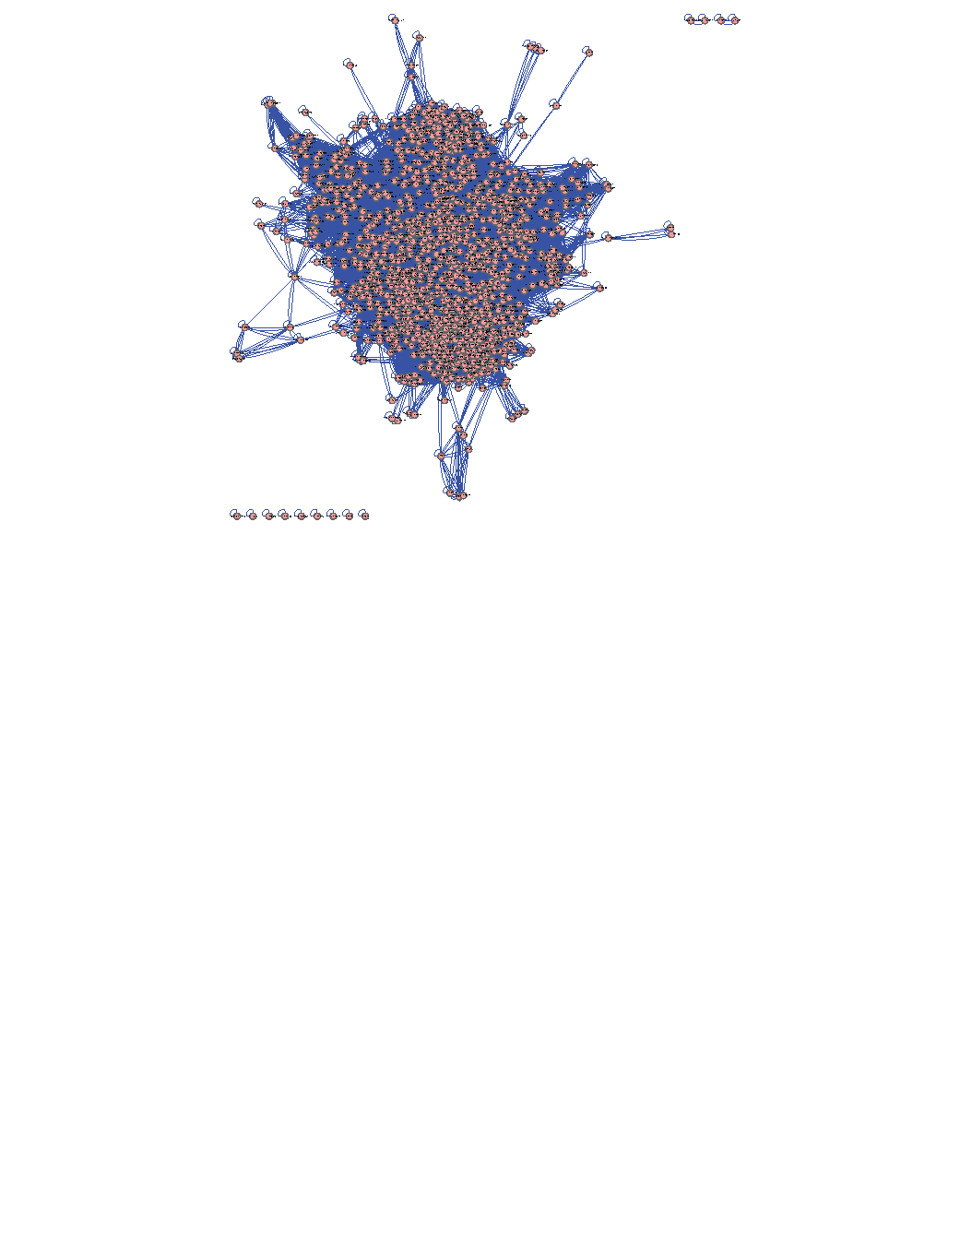
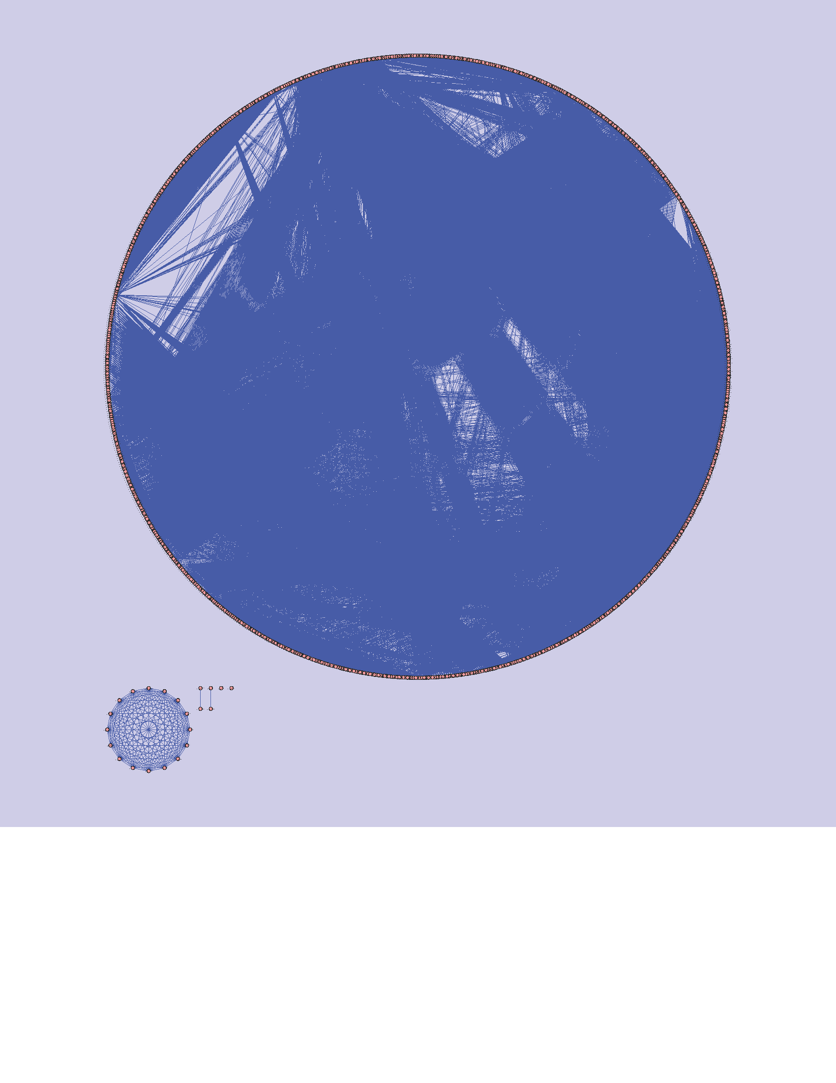
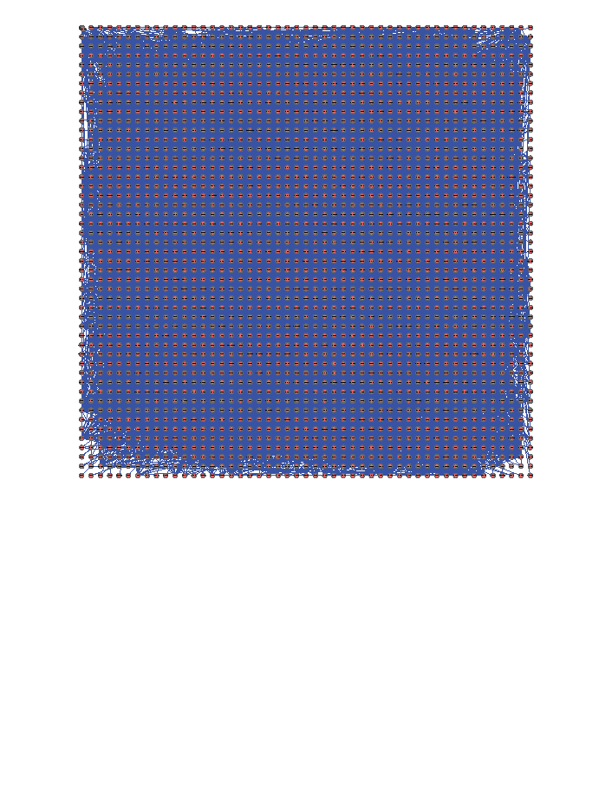
The Challenge
Making sense out of biological networks….

Slide 59
The Challenge
Biological networks
Seldom tell us anything by themselves
Analysis involves:
Understanding the characteristics of the network
Modularity
Comparison with other networks (i.e., random networks)
Visualization involves:
Placing nodes in a meaningful way (layouts)
Mapping biologically relevant data to the network
Node size, node color, edge weights, etc
…which then allowing for more analysis!

Slide 60
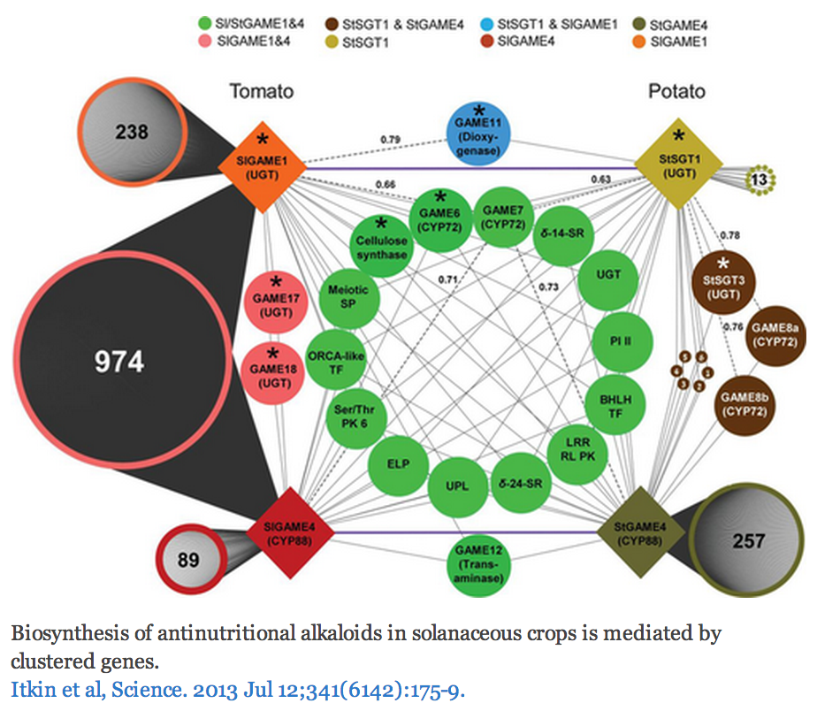
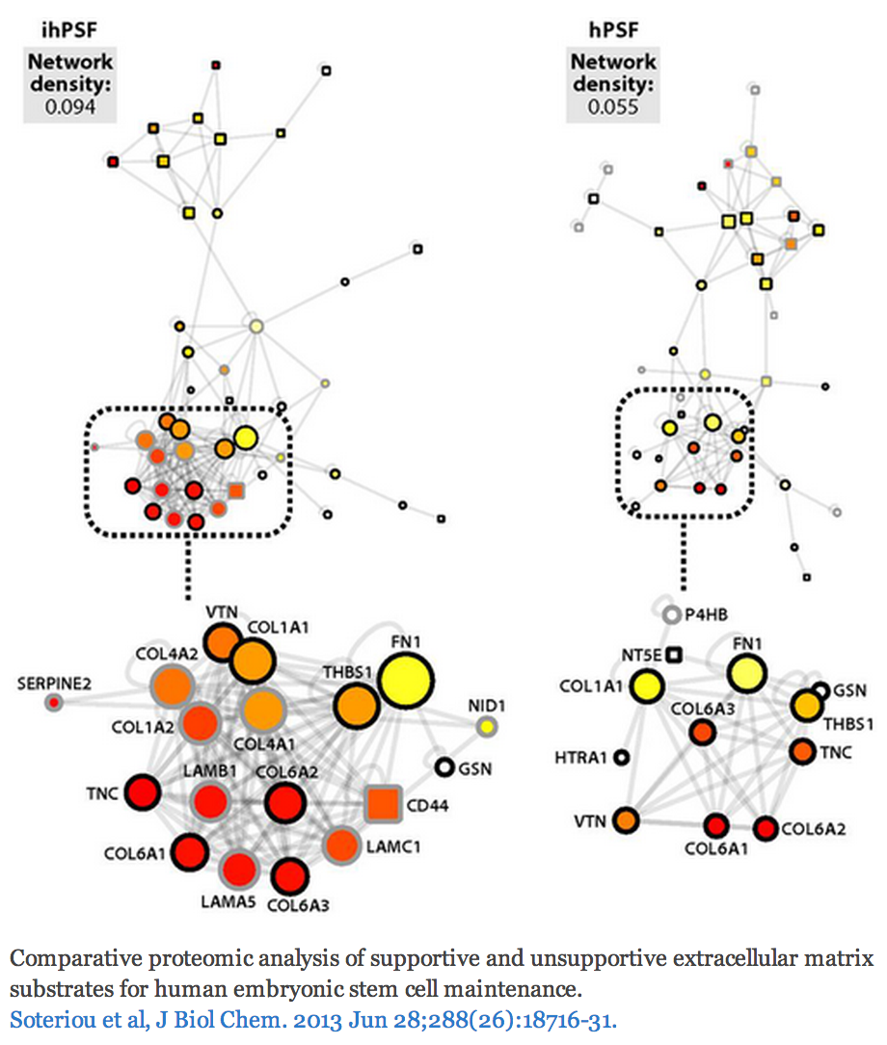
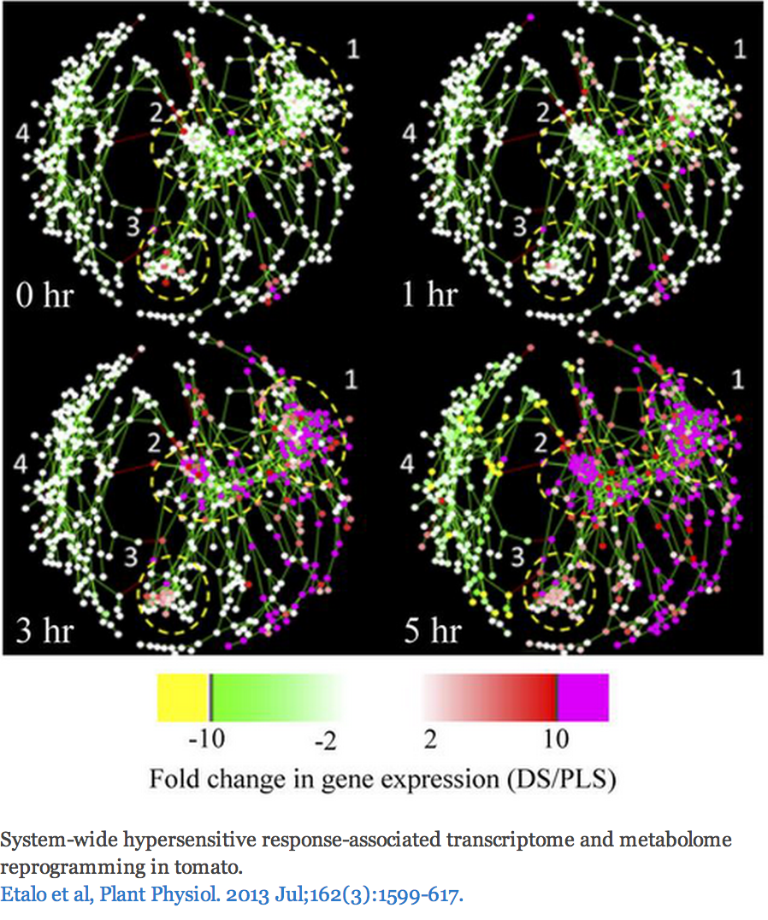
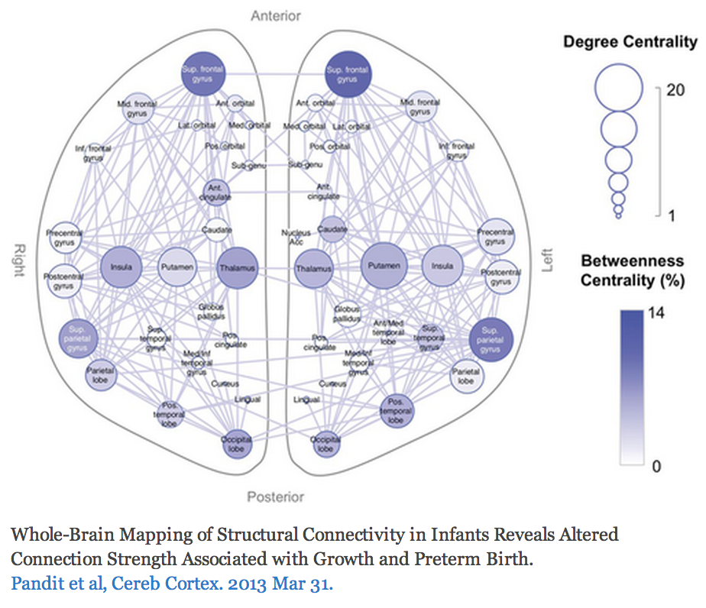
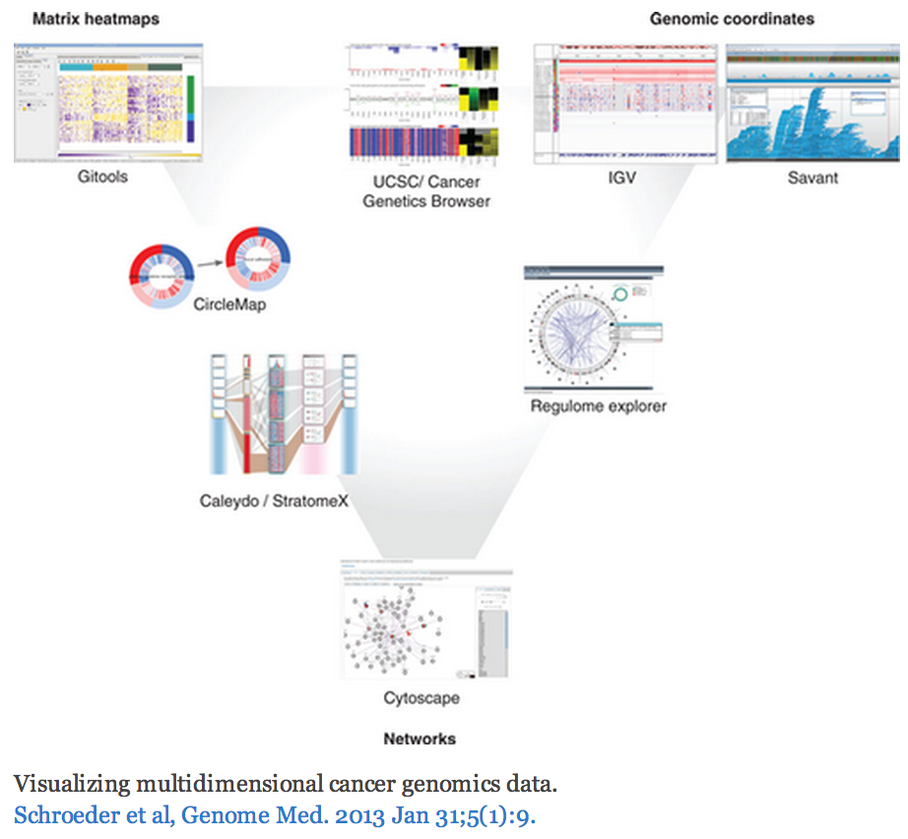
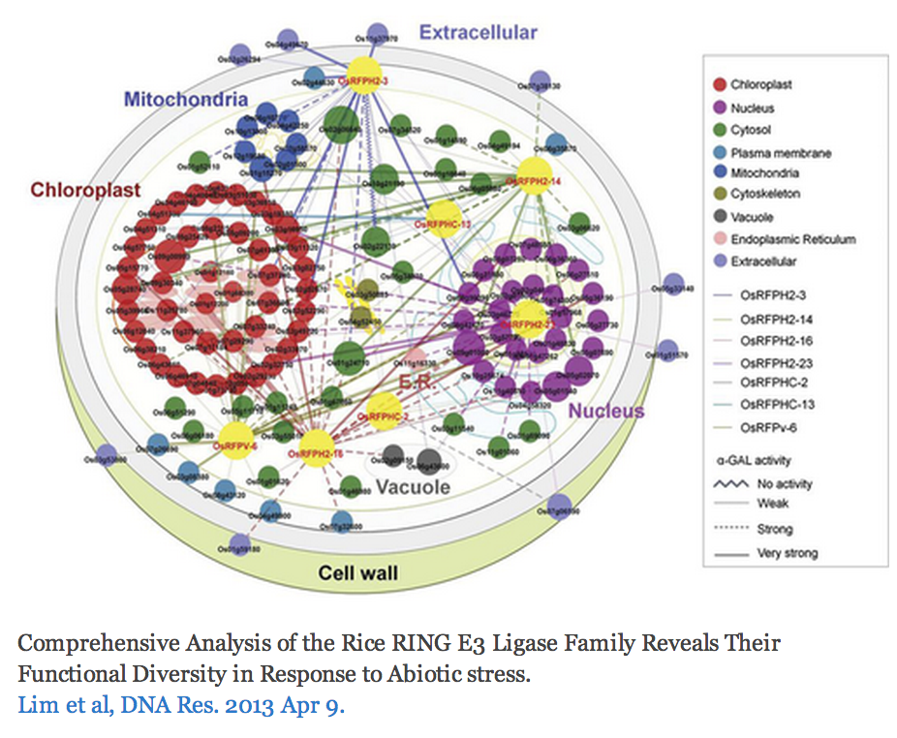

The Challenge
http://cytoscape-publications.tumblr.com/archive
Notes:
Some good examples
An example with perhaps too many visual properties
Cool cell illustration
Mapping brain regions (not proteins!)
Cytoscape is often just one part of an analysis pipeline

Slide 61
Biological Network Taxonomy
Pathways
Signaling, Metabolic, Regulatory, etc
Notes:
Signaling pathway: Interleukin-2
Metabolic pathway: Krebs (TCA) Cycle

Slide 62





Biological Network Taxonomy
Interactions
Protein-Protein
Protein-Ligand
Domain-Domain
Others
Residue or atomic
Cell-cell
Epidemiology
Social networks

Slide 63


Biological Network Taxonomy
Similarity
Protein-Protein
Chemical similarity
Ligand similarity (SEA)
Others
Tag clouds
Topic maps

Slide 64




Biological Network Taxonomy
Where do I get the network?
There is no such thing!
550 different interaction databases!
… in 2013
It depends on your biological question
and your analysis plan.

Slide 65

Biological Network Taxonomy
Where do I get the network?
There is no such thing!
… in 2016
http://ndexbio.org

Slide 66

Analytical Approaches
The levels of organization of complex networks:
Node degree provides information about single nodes
Three or more nodes represent a motif
Larger groups of nodes are called modules or communities
Hierarchy describes how the various structural elements are combined

Slide 67

Analytical Approaches
Piñero, Sci Rep, 15 April 2016
Notes:
“Cancer genes are central not only in terms of number of neighbors, but also in terms of the clusters they connect. Remarkably, we found that high Participation roles played by cancer genes are not explained by their higher number of interactions, but by their unique inter-modular connectivity patterns. We also found that these connectivity patterns differ for disease genes with contrasting inheritance modes: while autosomal dominant genes play high participation roles, autosomal recessive genes are more confined to their own modules. “
Replicates over 6 different interaction networks (HIPPIE¹⁸, BIANA⁴⁰, BioGRID⁴¹, IntAct⁴², IrefIndex⁴³ and from Human Interactome Project (HBI)^{19,44}). Looked at ~2000 Mendelian disease genes and 781 “cancer driver genes.”

Slide 68
Analytical Approaches
Network topology statistics such as node degree, degree distribution, centralitiy, clustering coefficient, shortest paths, and robustness of the network to the random removal of single nodes are important network characteristics.
Motif analysis is the identification of small network patterns that are over-represented when compared with a randomized version of the same network. Regulatory elements are often composed of such motifs.
Modularity refers to the identification of sub-networks of interconnected nodes that might represent molecules physically or functionally linked that work coordinately to achieve a specific function.
Network alignment and comparison tools can identify similarities between networks and have been used to study evolutionary relationships between protein networks of organisms.

Slide 69



Analytical Approaches
Concepts
Graph/Network correspondence
Node/Vertex correspondence
Edge directedness
Usually a network property
Multigraph
Allow multiple edges between nodes
Hypergraph
Allow edges to connect more than 2 nodes

Slide 70





Analytical Approaches
Network measures
Node degree
Indegree: # of edges for which this node is a target
Outdegree: # of edges for which this node is a source
Hub
node with an exceptionally high degree
Shortest path length
Shortest traversal distance between two nodes
Can be weighted if edges have weights or hops if not
Notes:
Network measures
Node degree
Indegree: # of edges for which this node is a target
Outdegree: # of edges for which this node is a source
Hub
node with an exceptionally high degree
Shortest path length
Shortest traversal distance between two nodes
Can be weighted if edges have weights or hops if not

Slide 71



Analytical Approaches
Network measures
Node degree
Indegree: # of edges for which this node is a target
Outdegree: # of edges for which this node is a source
Degree (undirected): # of edges incident to this node
Hub
node with an exceptionally high degree
3
4
3
10
3
3
Notes:
Network measures
Node degree
Indegree: # of edges for which this node is a target
Outdegree: # of edges for which this node is a source
Hub
node with an exceptionally high degree
Shortest path length
Shortest traversal distance between two nodes
Can be weighted if edges have weights or hops if not

Slide 72



Analytical Approaches
Scale-free networks
Degree distribution follows power law:
P(k) ~ k^{-γ}, where γ is a constant.
Result is that there are distinctive “hubs” (essential proteins?)
Overall, though, network is resilient to perturbation
Biological (and social) networks tend to be scale-free

Slide 73
Analytical Approaches
Network measures
Shortest path length
Shortest traversal distance between two nodes
Can be weighted if edges have weights or hops if not
2
1

Slide 74

Analytical Approaches
Small-world networks
any two arbitrary nodes are connected by a small number of intermediate edges
the network has an average shortest path length much smaller than the number of nodes in the network (Watts, Nature, 1998).
Interaction networks have been shown to be small-world networks (Barabási, Nature Reviews in Genetics, 2004)

Slide 75

Analytical Approaches
Random networks
Algorithms exist to create random networks
Flat random network: Erdos-Renyi (homogeneous, nodes have similar degrees, and not robust to arbitrary node failure)
Scale-free: Barabasi-Albert
Small-world (high clustering): Watts-Strogatz
Useful to compare your network vs. a random network

Slide 76
Analytical Approaches
Network measures
Clustering coefficient
Measures how close the neighbors of a node are to being a clique (fully connected group)
# of edges connecting a node’s neighbors/the node’s degree
1.0
0.5
0.3
0

Slide 77

Analytical Approaches
Centrality - measures of node importance
Degree centrality (find hubs)
Degree of this node / (# of nodes – 1)
Betweenness centrality (bottleneck)
The average number of shortest paths that go through this node / (# of pairs)
Closeness centrality
The sum of all shortest paths between this node and all other nodes / (# of nodes – 1)

Slide 78
Analytical Approaches
Network Analyzer Demo…

Slide 79
Analytical Approaches
Guilt by association
Combine weak signals to get a stronger one.
Two main applications:
Suggest network or functional relationship based on related data (e.g. co-expression).
Infer function or role (i.e. in disease) based on related data
Some algorithmic approaches
Random walk with restarts
Semi-supervised learning
Belief Propagation
Example: GeneMANIA

Slide 80
Analytical Approaches
GeneMANIA Demo…

Slide 81


Analytical Approaches
Motif finding
Search directed networks for network motifs (feed-forward loops, feedback loops, etc.)

Slide 82




Analytical Approaches
Finding subnetworks of similarly expressed genes
Finding the shortest path between nodes

Slide 83





Analytical Approaches
Overrepresentation analysis
Find terms (GO) that are statistically overrepresented in a network
Not really a network analysis technique
Very useful for visualization
Notes:
Note: all Cytoscape ORA tools provide a network visualization of terms and a ranked table with statistics

Slide 84






Analytical Approaches
Clustering (find hubs, complexes)
Goal: group related items together
Clustering types:
Hierarchical clustering
Divide network into pair-wise hierarchy
K-Means clustering
Divide network into k groups
MCL
Uses a flow simulation to find groups
Community Clustering
Maximize intra-cluster edges vs. inter-cluster edges

Slide 85
Visualization of Biological Networks
Data Mapping
Layouts
Animation

Slide 86





Depiction
Various ways to depict biological networks:
Node-Link (graph) representation
Partitioned Node-Link representation
Matrix representation
Can be useful for very dense networks
Can also map information into cells of matrix
e.g. degree, color scale (heat map)
Hierarchical reduction to 1D
Orthogonal 1D representation of nodes/edges
Notes:
Last two:
- NetGestalt (used to align data in fashion of genome browsers)
- BioFrabric (used to organize/explore massive hairballs)

Slide 87








Data Mapping
Mapping of data values associated with graph elements onto graph visuals
Visual attributes
Node fill color, border color, border width, size, shape, opacity, label
Edge type, color, width, ending type, ending size, ending color
Mapping types
Passthrough (labels)
Continuous (numeric values)
Discrete (categories)

Slide 88
Data Mapping
Avoid cluttering your visualization with too much data
Highlight meaningful differences
Avoid confusing the viewer
Consider creating multiple network images

Slide 89






Layouts
Layouts determine the location of nodes and (sometimes) the paths of edges
Types:
Simple
Grid
Partitions
Hierarchical
layout data as a tree or hierarchy
Works best when there are no loops
Circular (Radial)
arrange nodes around a circle
could use node attributes to govern position
e.g. degree sorted

Slide 90


Layouts
Types:
Force-Directed
simulate edges as springs
may be weighted or unweighted
Combining layouts
Use a general layout (force directed) for the entire graph, but use hierarchical or radial to focus on a particular portion
Multi-layer layouts
Partition graph, layout each partition then layout partitions
Many, many others

Slide 91
Layouts
Use layouts to convey the relationships between the nodes.
Layout algorithms may need to be “tuned” to fit your network.
There is not one correct layout. Try different things.

Slide 92

Animation
Animation is useful to show changes in a network:
Over a time series
Over different conditions
Between species
Notes:
http://git.dhimmel.com/SIDER2/similarity/

Slide 93
Introduction to Cytoscape
Overview
Core Concepts
Networks and Tables
Visual Properties
Cytoscape Apps
Working with Data
Loading networks from files and online databases
Loading data tables from CSV or Excel files
The Table Panel
Notes:
EDIT: according to schedule

Slide 94





Cytoscape
Open source
Cross platform
Consortium
University of Toronto
Notes:
NOTE: Pre-acknowledgements slide

Slide 95


Core Concepts
Networks and Tables
Networks
e.g., PPIs or pathways
Tables
e.g., data or annotations
Notes:
Notes: it is a Cytoscape goal that both the graph model and the data are free from Biological semantics

Slide 96

Core Concepts
Networks and Tables
Networks
Tables
Visual Styles

Slide 97



Core Concepts
Cytoscape Apps!
apps.cytoscape.org
Notes:
Screenshots: App Store front page, example app, and wall of apps
Note: mention increasing number of apps (and ports to 3.x)
Alternative: visit App Store live
272 apps – April 2016
97

Slide 98



Loading Networks
Use import network from file
Excel file
Comma or tab delimited text

Slide 99



Loading Networks
But what if I don’t have a network?!
Notes:
Welcome!
- web services: a couple provided by default (more in App Store)
- preset networks from BioGRID per species (mouse over for details)

Slide 100

Loading Tables
Nodes and edges can have data associated with them
Gene expression data
Mass spectrometry data
Protein structure information
Gene Ontology terms, etc.
Cytoscape supports multiple data types: Numbers, Text, Boolean, Lists...

Slide 101



Loading Tables
Use import table from file
Excel file
Comma or tab delimited text

Slide 102




Visual Style Manager
Click on the Styles tab
Notes:
New interface!
- def, map, byp
- example continuous mapping panel
- menu of provided visual styles

Slide 103


Selection Filters
Click on Select tab

Slide 104
Saving and Exporting
Sessions save everything as .cys files: Networks, Tables, Styles, Screen sizes, etc
Export networks in different formats:
SIF, GML, XGMML, BioPAX, PSI-MI 1 & 2.5
Publication quality graphics in several formats: PDF, EPS, SVG, PNG, JPEG, and BMP

Slide 105

Getting Help

Slide 106
Tips & Tricks
Network Collections
Each collection has a “root” network
Changing the attribute for a node in one network will also change that attribute for a node with the same SUID in all other networks within the collection
You can clone a network into a new collection to “decouple” it and start a new root

Slide 107
Tips & Tricks
Network views
When you open a large network, you will not get a view by default
To improve interactive performance, Cytoscape has the concept of “Levels of Detail”
Some visual attributes will only be apparent when you zoom in
The level of detail for various attributes can be changed in the preferences
To see what things will look like at full detail:
View→Show Graphics Details

Slide 108
Tips & Tricks
Sessions
Sessions save pretty much everything:
Networks
Properties
Visual styles
Screen sizes
Saving a session on a large screen may require some resizing when opened on your laptop

Slide 109
Tips & Tricks
Task monitor
Current task displayed in status bar (lower left)
Icon opens complete task history
Memory
Current status (lower right)
Toggle open for details and “Free Unused Memory” button
Notes:
Note: these used to be major issues in 2.x

Slide 110
Tips & Tricks
CytoscapeConfiguration directory
Your defaults and any apps downloaded from the App Store will go here
App Manager
This is where you search/install/update/uninstall apps
You now have the option of disabling vs. uninstalling…
Can also install and update apps directly from the App Store website, if you have Cytoscape 3 up and running

Slide 111
Cytoscape: Platform
Cytoscape as a platform
App architecture
http://apps.cytoscape.org
Use cases
Expression data analysis
Protein complexes
Agilent literature search

Slide 112
Hands-on Tutorial
Introduction to Cytoscape:
Networks, Data, Styles, Layouts and App Manager
tutorials.cytoscape.org

Slide 113
Hands-on Tutorial
App Tutorials:
http://tutorials.cytoscape.org
http://rbvi.ucsf.edu/cytoscape/structureViz2/tutorial.html
http://rinalyzer.de/tutorials.php
Notes:
TODO: Update

Slide 114
Examples/Demos
clusterMaker
Clustering and cluster visualizations
Agilent LitSearch Tool
Extracting networks from abstracts
WikiPathways
Search and load pathway diagrams
Notes:
clusterMaker:
- simple: galFiltered -> BiNGO
- complex: collins PPI
litSearch:
- CDC25, human, cancer
WikiPathways
- human: TCA, Statin or 5-FU

Slide 115


Expression Data Analysis
Load galFiltered.cys
Explore the expression fold changes: gal1RGexp, gal4RGexp, and gal80Rexp. The network is colored by gal4RGexp values.
To explore the expression profile for these three deletions, we can use clusterMaker to do a hierarchical cluster
Apps→clusterMaker→Hierarchical
Choose the attributes we’re interested in (node.gal1RGexp, node.gal4RGexp, node.gal80Rexp)
Choose the type of clustering (pairwise average-linkage, Euclidean distance)
Click “Show TreeView when complete”
Click OK
Notes:
The example file, galFiltered.cys is included with all Cytoscape releases. It is taken from Ideker, et.al. 2001, although it has gained significantly more annotations over the years. It shows a protein-protein interaction network that focuses on the galactose (gal) utilization in the yeast Saccharomyces cerevisiae. The network was perturbed by gene deletion of the major GAL genes, then the cells were grown in the presence and absence of galactose.

Slide 116


Expression Data Analysis
After the clustering is complete (very fast) the Tree View will be shown
If the colors are too dark, they can be adjusted in the Settings… dialog.
Select the dendrogram branch at the top, as shown
Note that this will also select those proteins in the network view

Slide 117


Expression Data Analysis
Now we can see if these genes show any GO overrepresentation
Start BiNGO
Apps→BiNGO
Give the clusters a name (e.g. cluster1)
Click on Start BiNGO to process the data
The results include a table and a network of GO associations
In this case the top term is “galactose catabolic process via UDP-galactose,” which makes good sense

Slide 118






Expression Data Analysis
Active modules
The jActiveModules app identifies clusters that show differential expression over user-specified conditions or time-points
Go to the jActiveModules tab in the Control Panel
Select the galFiltered.sif interaction network
Select the attributes that contain the gene expression p-values: gal1RSig, gal4RSig, gal80RSig
Click Search
Explore the resulting networks
Overview network shows the overlap between the active modules
Color nodes according to expression to see the significant changes
Apply BiNGO on one of the active modules

Slide 119

Protein Complexes
Load collinsPlus.cys
Three networks, but only one view
combined_scores_good.txt: Combined MS/TAP Yeast PPI network from Collins, et. al.
DNA and Tran 07-21-06b.csv: Yeast EMAP
RNAPuberNov2+Meg6c.csv: Yeast EMAP

Slide 120


Protein Complexes
Load collinsPlus.cys
Three networks, but only one view
combined_scores_good.txt: Combined MS/TAP Yeast PPI network from Collins, et. al.
DNA and Tran 07-21-06b.csv: Yeast EMAP
RNAPuberNov2+Meg6c.csv: Yeast EMAP
Find MCL clusters in the PPI network
Apps→clusterMaker→MCL cluster
Density Parameter: 1.8
Array source: PE Score
Cutoff value to minimum (1.85)
Select “Create new clustered network” and “Restore inter-cluster edges after layout”

Slide 121

Protein Complexes
Now that we have PPI clusters, we can explore some EMAP data
Select the “DNA and Tran…” network
Now perform a hierarchical cluster
Apps→clusterMaker→Hierarchical Cluster
And select “DNA Strength” from Edge
Click on Visualize Clusters to bring up the TreeView

Slide 122



Protein Complexes
Now that we have PPI clusters, we can explore some EMAP data
Select the “DNA and Tran…” network
Now perform a hierarchical cluster
Apps→Cluster→Hierarchical Cluster
Click on Visualize Clusters to bring up the TreeView
Select your PPI clustered network in Cytoscape
Search for GIM5 and select the entire cluster
Note how the proteins in TreeView highlight
Note that BUD27 doesn’t cluster very well in EMAP
Deselect BUD27 edge

Slide 123





From Networks to Structures
Cytoscape apps: structureViz2, RINalyzer, cddApp, chemViz2
Load pte.xgmml
Protein similarity network of the Phosphotriesterases family
Open the structure 1EZ2 in Chimera and explore it
Select nodes and invoke the node’s context menu Apps→ structureViz→ Open Structures for Node(s)
Use the Molecular Structure Navigator to enhance the display
Create a residue interaction network
Select residues in the structure and use the top menu bar Chimera→ Residue network generation menu

Slide 124
Questions?
scooter@cgl.ucsf.edu
cytoscape-helpdesk@googlegroups.com

